Slide 1
Preventing Devoops with DevSecOps
Kieran Jacobsen
Technical Lead – Infrastructure & Security
Notes:
Good morning everybody, my name is Kieran Jacobsen, I am the Technical Lead for Infrastructure and Security within Readify’s Managed Services team. My focus within Readify is the management and maintenance of Readify’s internal systems and infrastructure. That might seem simple, but ensuring that our infrastructure and systems are available for 220 incredible talented individuals actually takes a lot of work. I also work as a connector between our developers, customers operations and security teams, and recently Telstra’s operations and security teams. I have seen what works, and what doesn’t work.

Slide 2
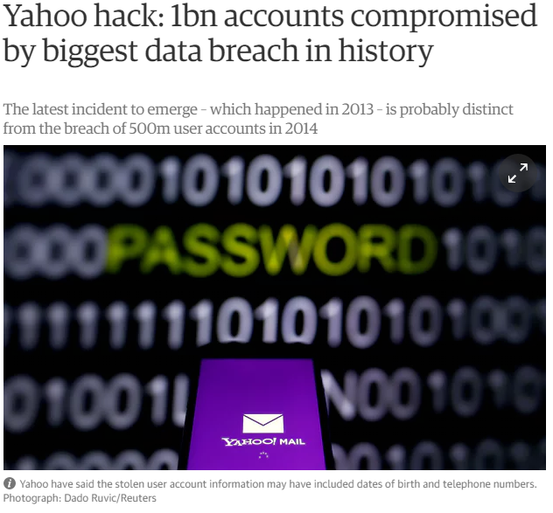
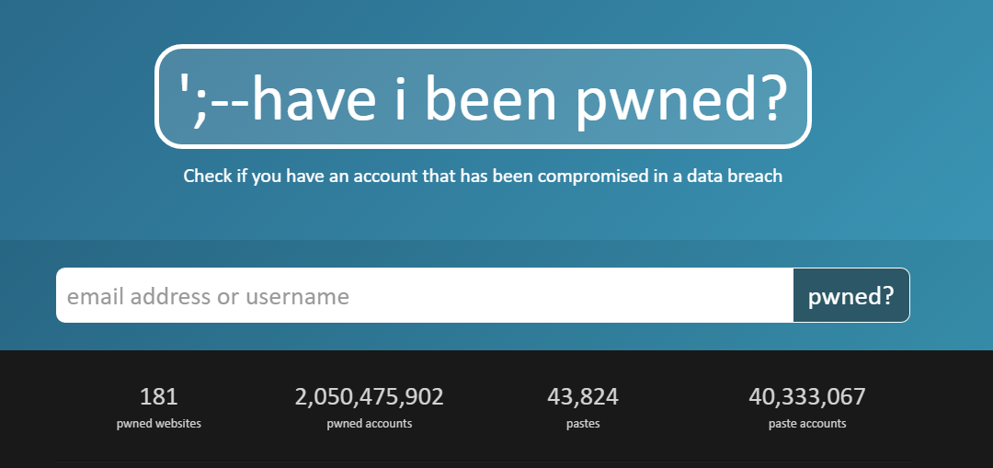
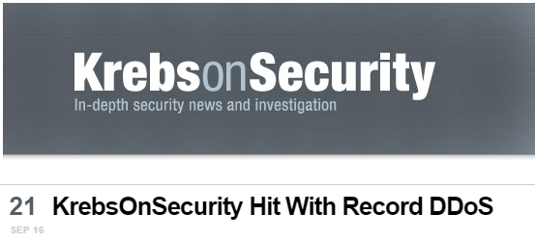
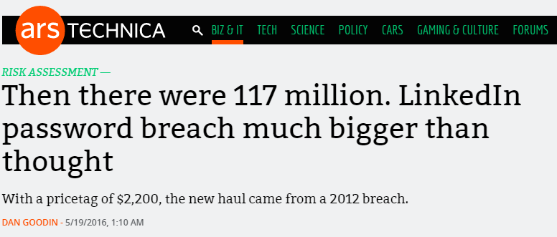
2016 was a big year…
Notes:
By all accounts, 2016 was a massive year for information security. We saw a significant number of breach disclosures, breaking records in terms of the number and size of the breaches. We saw a number of older breaches appear for the first time, like those impacting LinkedIn, Myspace and Yahoo. We saw the mirai bot net appear, hit Brian Krebs with a record breaking denial of service attack, then target DynDNS and knocking off Spotify, twitter, GitHub PayPal and more. We also saw a number of breaches where database backups made public, including one impacting the Australian Red Cross.

Slide 3
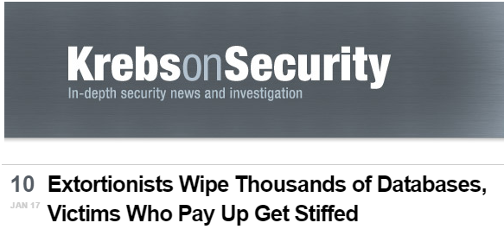
2017 is getting of to a bad start…
Notes:
Yet 2017, politics aside, seems to be gearing up to be even worse. Attackers have laid waste to poorly secured Hadoop, MongoDB, ElasticSearch and CouchDB instances; deleting data and leaving ransom notes. We also saw a suspected DDOS take down Lloyds bank for 2 days. Recently, we saw an employee delete the wrong folder of files, taking down GitLab for several days and finally a 13 year old worm made a reappearance. That’s right, SQL Slammer is back!
If this is what happened January, I can’t wait to see how things heat up further.

Slide 4
Before DevOps
Notes:
Here we see a representation of development and operations before the introduction of DevOps. Development would catapult new builds at operations, and they would return with a volley of bugs and issues. Our applications were unstable, deployments were a complex mess and overall our organisations suffered.

Slide 5
DevOps
Notes:
Along came DevOps, with a promise that we would get two waring factions to act as one, and fight a common enemy, users. DevOps has largely been a success, applications have become more stable, we now have a faster release cycle, with fixes deployed to production often at an hourly basis. Development and Operations is now moving at a speed to which the rest of the business was wanting. Gartner predicted that 2016 was the year DevOps goes mainstream, with 25% of the businesses using DevOps by 2017. HP Enterprise, my old employer went so firmly as to say that within 5 years DevOps will be the norm when it comes to software development.

Slide 6
But Where Is Security?
Notes:
Somehow, in the race to embrace the benefits of DevOps, organisations didn’t include their own security teams. And Whilst we like to think of DevOps as encouraging security, the result has been the wild west. We have insecurely deployed servers, databases and applications. Organisations have forgotten things like backups, and disaster recovery. It really does feel like the dotcom boom, everyone is happy, but the word is crumbing. If 2016 is the year that DevOps goes mainstream, then 2017 will surely be the year that attacks against DevOps becomes the norm.

Slide 7
DevSecOps
Clear Communication Pathways
Streamlined Communication
Security As Code
Training
Integrate Security into DevOps cycle
Notes:
So how do we achieve DevSecOps. We need to start by creating clear and precise communication pathways with streamlined communication. We need to consider security as code, and invest in training. I am going to finish by looking at how we can include security within the DevOps cycle.

Slide 8
We're in customer service. Our users are our customers. We need to understand them & their needs to do our job well!
Jess Dodson (@girlgerms)
Notes:
This quote from Jess Dodson, a local MVP sums up some of the challenges we are facing within IT right now and in the relationship between the three groups. We’re all in customer service, our users are our customers, we need to understand them and their needs to do our job well. This is so true, but we often forget that these three groups are also customers of each other, and we need to treat those relationships between these three just like any other customer service role. When I get back to Melbourne, I am looking at putting this up and framing it.

Slide 9
Communication Pathways
Development
Operations
Security
Notes:
So here we have the three groups. As expected, we have development and operations.
<click>
Now In DevOps, we recognise that these two need to work together to achieve beneficial outcomes. The organisation as a whole, expects development to keep creating new things, new software builds etc; to do this, they need ops to provide internet access, workstations, test machines and much more. Converse, the business expects stability from operations which results in ops needing dev to high quality code, and stable applications for them to install. Dev is a customer of operations, but conversely, Operations is a customer of development.
<click>
So where does security fit in? Well security need development to write high quality code, and security is a factor of quality. Security also need operations to do things like patching, vulnerability remediation and replacing old pieces of infrastructure. Security is a customer of development, and operations.
<click>
Now for the bit that most people miss, development and operations are customers of security. Security needs to realise that for the other two teams to succeed, they need guidance, assistance and support.
So, how do we support this? The first step is by communicating more effectively with each other.

Slide 10
Hiring Ratio
DEVELOPERS : OPERATIONS : SECURITY
100 : 10 : 1
Notes:
One thing that has always shocked me is the difference in hiring numbers with an average organisation. Before I reveal the actual ration, I want everyone to briefly consider what the ration between developer hires, operational and security hires is. To help you, how many developers and operations staff are hired for a single security professional?
That's right, organisations hire 100 developers and 10 ops team members for each security person.
Developers need to be aware that the operations team is not just there to support development. It is an extremely common misconception, particularly in development, but also in other parts of an enterprise, that operations sits and waits for requests. The 10 in operations that we see here, are often supporting the rest of the organisation as well, and supporting the business can often be exceptionally time consuming. If you add process like change management, and then all of the other things you need to do, like training etc, your operations staff are stretched quite thin. The same goes for Security.
DevOps can help this, however its critical to realise that in most organisations, even with a DevOps focus, operations is a time consuming process. A few years back, I worked in an organisation of roughly 1500, 150 of which were IT. This included developers, operations, and security, as one of operations, hypothetically speaking, I not only need to support 10 developers and ensure they have everything that need, but I also have another 140 non technical staff to support as well.
And this rounds out our discussion of expectations. When I hear the statement “Ops a hopeless, it takes them a week to provision a single virtual machine”, you need to consider the work it takes to build a virtual machine! It often requires miles of paper work, coordination with a variety of teams and then I need approval from management and different teams. I often only get one slot per week for approval as well, so if you missed that one, you could be forced to wait a week. I have to do all of that, whilst supporting 9 other developers and 140 other staff members. Now who is being unreasonable? ** talk about communication via tickets and setting expectations **

Slide 11
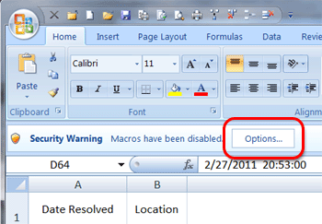
Streamlined Communication
NO:
Excel checklists
Word document reports and policy documents
Email attachments
Notes:
In most organisations, security processes often heavily rely on excel checklists, word documents and email attachments. This was fine 10 years ago, but it isn’t appropriate now.
Excel was designed for financial information and numerical data, not checklists. Recently I had to work through over 12 000 security questions all in macro enabled excel files. I hope you can see the issues with this as I did. I have one made one decision this year, and that is, I will not respond to any more security reviews on macro enabled spreadsheets.
Word documents are heavily relied on for reports and policy documents. People don’t have time to read a 500 page security report, and word isn’t great for policies, as its hard to maintain a version history. We can’t easily tell what has changed between one version and the next, am I compliant with security policy 1.1.16? Guess I need to read all 150 pages to find out what changed from 1.1.15 so I can tell.
Email attachments inhibit collaboration, they are great for broadcasting information, but not great for a team working on a report together. You also need to be aware that not everyone runs their mail servers like you might, do you want to send sensitive information to that partner via email?
So how should we communicate to facilitate better teams and improve productivity?

Slide 12
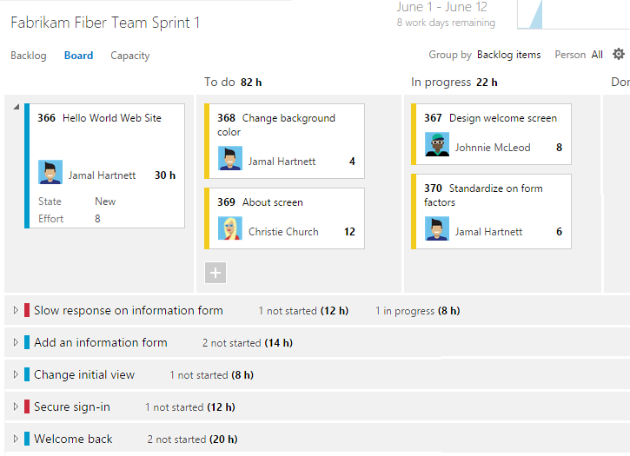
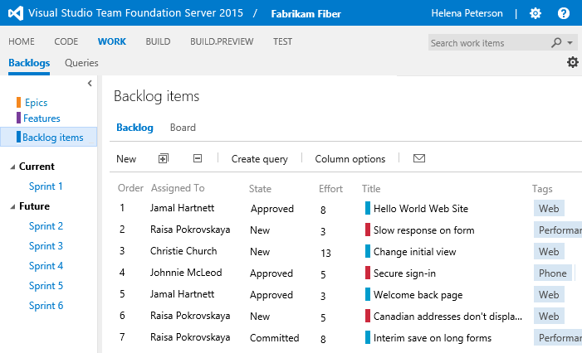
Streamlined Communication
YES:
Backlogs/boards
Notes:
Work backlogs and boards have done wonders for agile and devops, and we extend upon this for DevSecOps. They encourage collaboration and ownership. Teams work together to determine priorities, and there is a clear progression of activities. Security teams don’t produce reports in word or PDF, instead they create tasks in a backlog. This allows for clear prioritisation, and ownership.

Slide 13
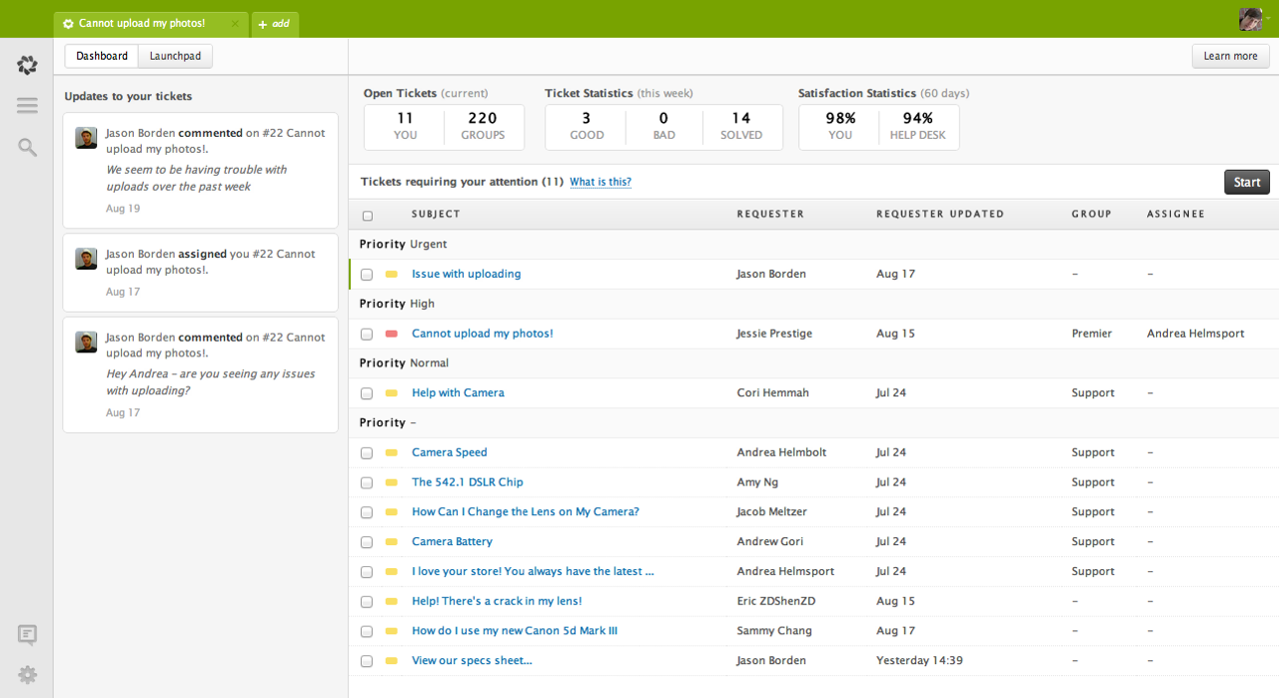
Streamlined Communication
YES:
Backlogs/boards
Support ticketing
Notes:
Don’t underestimate the effectiveness of support and helpdesk tools like Zendesk here. They are great at managing an alert stream, maintain change history, encourage teams to work better and more efficiently. Automated responses can save time, and including developers and security, not just ops, allows for issues to flow smoothinly from team to team.
<example>

Slide 14
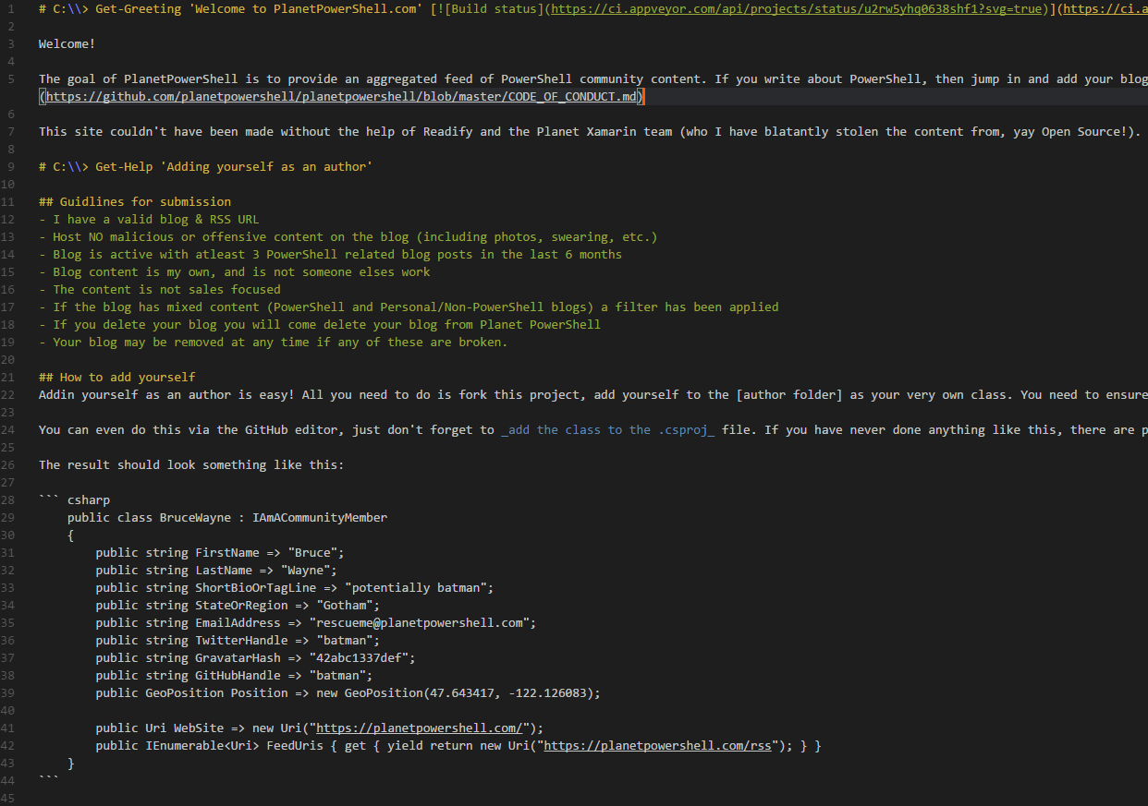
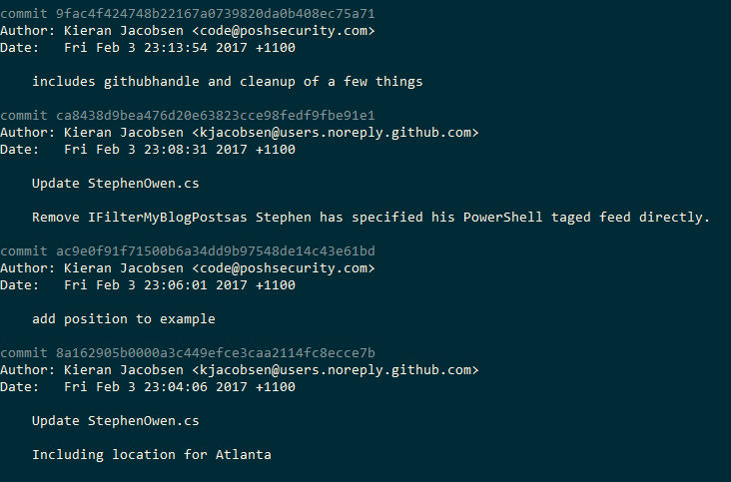
Streamlined Communication
YES:
Backlogs/boards
Support ticketing
Markup and Git
Notes:
The last communication tool, is actually a language and a tool. Documentation needs to be simple and easy, and that is why we often fall back to things like Word, Excel and OneNote. Personally, until recently I was a bit suspicious of using markup and git for documentation. Markup can be hard to work with, would be really be good for documentation?
When we use Markup with Git, we gain a way of determining the changes from one version to the next, we can easily see who made a change and why, and with Git pull requests, we can have a workflow where changes are reviewed before they are pushed out to the rest of the team, or the rest of the business.
For instance, say we find an issue with the security policy, as a sysadmin, I make the changes, and create a pull request for security to review. Security reviews the pull request and merges the changes. This is now available to the business.
It is worth highlighting that there are plenty of ways to present this information in a friendly way to the rest of the business, we could push it up to a web page, or turn them into word or pdf files. This could be performed automatically at commit.

Slide 15
Security As Code
Application Source Code
Azure ARM and AWS Cloud Formation
Server Configuration – Chef, Puppet, DSC
Notes:
So the next big takeaway is security as code. Or as I like to put it, here is all of the code that could impact your organisations security.
So obviously we have application source code, but what about the other parts of your environment?
If your developers are using Azure or AWS, they are probably using templates to deploy infrastructure. Care needs to be taken that these templates are created in a way that the infrastructure they deploy is secure. Does operations review these? What about security?
Server configuration tools like Chef, Puppet and PowerShell DSC are all the rage, but I often see two major issues. Firstly the tools themselves are often not secured correctly, these tools often have vulnerabilities in their management interfaces, and at times accessed over HTTPS with weak credentials. Try to imagine getting a hacker out if your configuration tools are recreating their backdoored accounts. Just as importantly, are these tools deploying the most secure configuration possible to servers? These tools are great at pushing out security configurations like SSL hardening, application patches and secure service configuration.

Slide 16
ARM Templates
Notes:
So Azure Resource Manager Templates, or ARM Templates for short. Allow us to deploy services within Azure in a repeatable manner. This includes things like storage, networks, addresses, virtual machines, web apps, SQL databases and much more.
In this example, we see a configuration element relating to a Network Security Group, basically this is an ACL. I have taken this from the Azure Quick start templates. This NSG specified that the only traffic allowed to this system is RDP, port 3389. Unfortunately, they have allowed all the internet as a source address, so I guess someone will start brute forcing this box soon enough.
Now I am not surprised by this one, from experience, this is actually better than the majority of templates I see. The majority of templates do not even apply network security groups, resulting in all services, from RDP to SSH to SMB to SQL left exposed to all in sundry.
Do you know if your developers are deploying from examples like this?

Slide 17
PowerShell DSC
Notes:
So let’s take a quick look at another example, this type its PowerShell DSC. This example is snipped of a much larger DSC configuration that all of our servers at Readify comply to. This will disable insecure ciphers being used for HTTPS connections. Imagine the effectiveness if you pushed this out to all of your web servers, or better yet, every server in your fleet?
This is security as code. We are making our environment more secure using code.

Slide 18
Training
We can’t be experts in Dev, Sec and Ops
We need cross pollination of skills
Starts at day 0
Notes:
It is a fact of life, and a fact within our industry, that we cannot be experts in everything. We cannot be an expert at development, security and operations. I can’t be an expert in C# and Pen Testing and Deploying Exchange Servers.
To succeed in DevSecOps, we need teams that have a cross pollination of skills, the developer who understands application vulnerability testing, the sysadmin who can program, the security engineer that understands web server configurations. With new skills comes new patterns in our thinking, and we come up with new ways to solve the problems we are presented with.
Security awareness begins on the first day. When new hires start, not only should they receive the usual basic training on passwords and shoulder surfing, but they need specialist training. Developers should receive training on the quality expectations of the code that they are writing, the basics of secure coding and the most common exploit vectors. Senior developers should go on training courses covering secure coding practices and the common mistakes, not only does this give them ownership of security, but forces them to think through theses issues, which is critically important. Senior developers are the mentors for the junior developers, they are also the ones who perform the daily pull request reviews.
Training isn’t a once off thing, it’s a multiple times per year thing. Training is not just a PowerPoint slide, nor is it the same video each year. Training needs to be reviewed regularly to ensure it covers the latest technology and the changes in the security landscape.

Slide 19
Training: Phishing
Notes:
At Readify, we identified that phishing was a critical risk to an organisation. Technology can only solve so much, there isn’t a silver bullet. So we opted to organise some training. We selected an external vendor that had a three step process.
The first is a baseline, every use gets an email, the same email, throughout a month long period. After baseline comes training, and then once training is complete, there is a period of continual training. During this final phase, staff get one phishing email each month to test them and to help hone their skills.
Before we look at the results, lets look at the break down of staff at Readify. <click> As you can see, the majority, around 80%, of our employees are technical, be it developers, database people, business intelligence, SharePoint, or infrastructure people like me. My expectation was that the majority of those who fell for the baseline email, would be non-technical, I know, I am biased.
<click>
As you can see, the results are a tad more interesting. Overall, we had 26% of our staff click on the baseline email, surprisingly, only a small fraction of those, 2 people, were non-technical. Since the training, our click rate is down to about 2% each month.
Moral of the story, don’t always expect your non-technical staff to be the source of your security issues.

Slide 20
Integrating Security
Notes:
So back we are to the infinite loop that is DevOps. So where should we integrate? The answer is, at every single step along the way. Security is something we need to consider at every step, we use to say security is as strong as the weakest link in the chain, well this loop here is your new chain, lets make sure everything is as strong as it can be.
Automation is crucial here, we need to be able to integrate our security tools with the rest of the continuous build and release pipeline. If your tool needs to be manually triggered, or cannot feed its results back into a backlog, or into a support ticket system, it isn’t going to succeed.

Slide 21
Plan
Integrate security into sprint planning and reviews
Consider security user stories early
Notes:
As we spoke about earlier, its crucial to involve security teams in the sprint planning and review process, I also believe that you need to consider any security stories or work items as early as you can in your project. Security stories can be complex, and you don’t want them to be rushed towards the end of a project.

Slide 22
Code
Training!
Test driven development
Use of the correct tools
Pull Requests
Notes:
So training reappears. How do we write good code, well, we ensure of developers know how to write good code through proper training.
Another thing that I think is crucial at this point is the use of test driven development. If we are writing unit tests for a specific module of code, why not include security tests. That way as the model is then written, we are already working to ensure that it is following security practices.
Tooling is also very important here. There are a bunch of IDEs and plugins that will alert a user to bad practices, invest in these to help developers spot problems earlier on.
Pull requests, and their associated code reviews are also critical. You should ensure that no one approves their own pull request, no matter the urgency, and you should ensure that whoever is performing the review has received adequate security training. If they are new to the review process, consider using a buddy who has a history of approving high quality code and providing good feedback. Pull Requests with obvious vulnerabilities do not get pushed into pre-production or production environments.

Slide 23
Build
Static code analysis
Dynamic code analysis
Notes:
During the build process we can look at using static and code analysis tools. The argument over which is better, is as old as the industry, and I am not going to enter it. What is worth noting is that these tools need to be correctly tunned, they often don’t take into account any other mitigations that we might have deployed within your environment. Care needs to be taken with the alerts that they generate.
A build that fails its security checks isn’t of high enough quality to proceed further down the pipeline. Ensure that everyone is aware that the expectation is for high quality code to proceed to testing and onwards.

Slide 24
Test
Develop security test cases
Fuzzing
Load testing
Notes:
Automated testing is so critical for a DevOps and a DevSecOps project. Testing is how we ensure that our code is up to scratch and its of quality that we would want to deploy it. When Testing, be it unit testing, or automated UI testing, or even formal manual user acceptance testing, include security test cases, that is cases that can be used to ensure the system is performing securely. A simple example of this might be that if a user was to enter SQL injection into a webform, that the form doesn’t output SQL errors.
Fuzzing is another technical that is becoming popular, it’s the process of sending random inputs to software to spot security holes. A number of vendors are producing not only great fuzzing tools, but ones that allow for automated tests with integration into our build and release pipelines. Microsoft recently announced Project Springfield, a tool its been testing in house and with customers.
Another bit of testing that can be automated, and is so often overlooked is load testing. I can’t believe its 2017, and people still don’t do load testing. Load Testing not only proves that the application infrastructure can handle the load, but it can also help us determine if it can handle more than what is expected, say in the event of an attack. Microsoft includes support for load testing in their VSTS platform.
Once again, if the app fails in testing, it doesn’t proceed.

Slide 25
Release & Deploy
Automated scanning upon deployment
Notes:
When an application gets to the release and deployment stages, we might think there is nothing for us to do; this isn’t the case, at this point, we may have deployed an application into a development or pre-production environment prior to deployment on production. Why not perform an end-to-end vulnerability assessment, scan not just the application but the entire stack, from servers, to databases, to load balancers. This is potentially your first time seeing the application and its supporting elements in its entirety, make use of the opportunity.

Slide 26
Operate & Monitor
Monitor logs
Rescan for vulnerabilities
Have a structured patch process
Track dependencies

Slide 27
Summary
Clear Communication Pathways
Streamlined Communication
Security As Code
Training
Integrate Security into DevOps cycle

Slide 28
Thank You

