Slide 1
Preventing Devoops with DevSecOps
Kieran Jacobsen
Technical Lead – Infrastructure & Security
Notes:
Hi, My name is Kieran Jacobsen, I am the Technical Lead for Infrastructure and Security at Readify. Today I am going to talk about DevSecOps in 10 minutes!

Slide 2
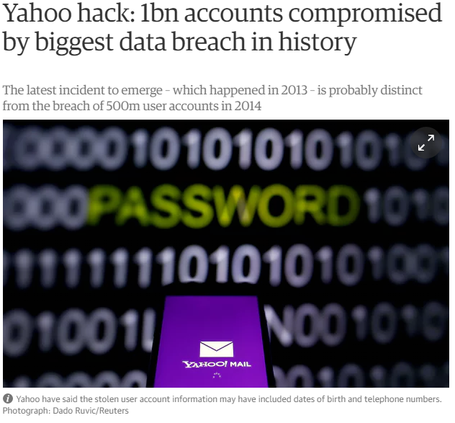
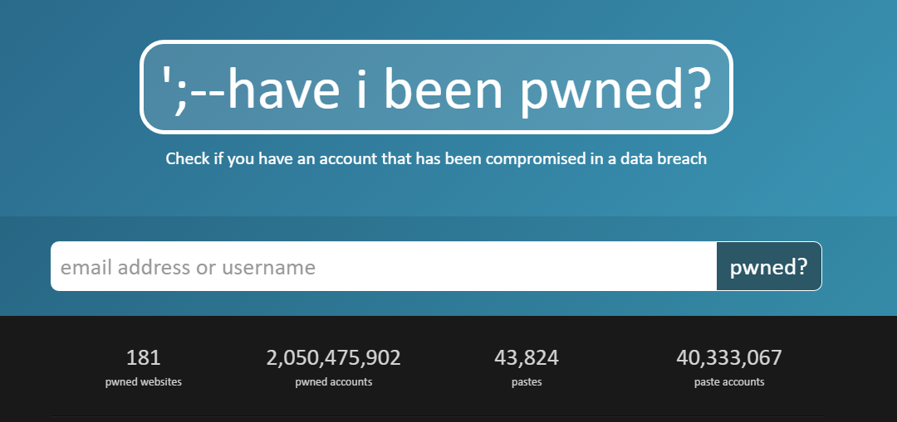
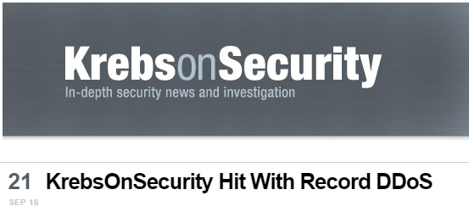
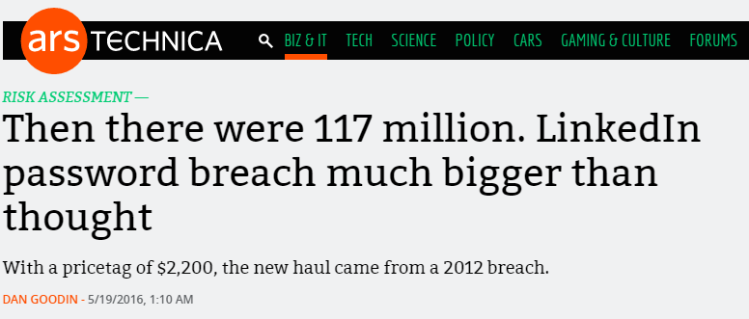
2016 was a big year…
Notes:
By all accounts, 2016 was a massive year for information security. We saw a significant number of breach disclosures, breaking records in terms of the number and size of the breaches. We saw a number of older breaches appear for the first time, like those impacting LinkedIn, Myspace and Yahoo. We saw the mirai bot net appear, hit Brian Krebs with a record breaking denial of service attack, then target DynDNS and knocking off Spotify, twitter, GitHub PayPal and more. We also saw a number of breaches where database backups made public, including one impacting the Australian Red Cross.

Slide 3
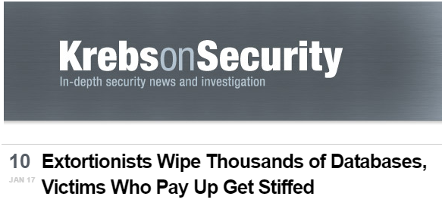
2017 is getting of to a bad start…
Notes:
Yet 2017, politics aside, seems to be gearing up to be even worse. Attackers have laid waste to poorly secured Hadoop, MongoDB, ElasticSearch and CouchDB instances; deleting data and leaving ransom notes. A 13 year old worm made a reappearance. That’s right, SQL Slammer is back!

Slide 4
Before DevOps
Notes:
Here we see a representation of development and operations before the introduction of DevOps. Development would catapult new builds at operations, and they would return with a volley of bugs and issues. Our applications were unstable, deployments were a complex mess and overall our organisations suffered.

Slide 5
DevOps
Notes:
Along came DevOps, with a promise that we would get two waring factions to act as one. DevOps has largely been a success, applications have become more stable, we now have a faster release cycle, with fixes deployed to production often at an hourly basis. Development and Operations is now moving at a speed to which the rest of the business was wanting.

Slide 6
But Where Is Security?
Notes:
But in the rush, we missed something, we left out security from the equation. Organisations at all levels rushed to embrace DevOps, yet at times, didn’t include their own security teams. We see insecurely deployed databases and applications, and issues with backups and disaster recovery being over looked. It feels almost like we are back in the 90s.

Slide 7
DevSecOps
Clear Communication Pathways
Streamlined Communication
Security As Code
Training
Integrate Security into DevOps cycle

Slide 8
We're in customer service. Our users are our customers. We need to understand them & their needs to do our job well!
Jess Dodson (@girlgerms)
Notes:
I love this quote from Jess one of our local MVPs. We’re in customer service. Our users are our customers. Its also clear
Here I have one of my favourite quotes about the industry and it comes from a Queensland Microsoft MVP, Jess Dodson; “We’re in customer service. Our users are our customers. We need to understand them & their needs to do our job well. What I love about this quote is that it succinctly sums up some of the issues with the relationship between Development, Operations and Security. We are all in customer service, and its about time we start acting like we were, long gone are they days of the cold face of IT. Its also crucial to realise, that within these three groups, we are both customers, and providers.

Slide 9
Communication Pathways
Development
Operations
Security
Notes:
Now, its obvious that Development and Operations need to maintain clear communications. If development wish to provide new products, ie code, they need operations to provide them with things like internet. And If Ops wants a stable environment, they need development to write high quality code. Development is a customer of Operations, and Operations is a customer of development. We need clear communication between these groups.
What we often miss is the customer relationships with security. The security team needs dev and ops to deploy fixes to discovered security issues, they are a customer of these two teams. What we forget, is reverse. Development and Operations are not security experts, they require support, guidance and assistance from security specialists.

Slide 10
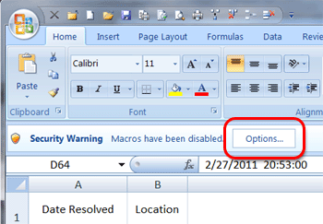
Streamlined Communication
NO:
Excel checklists
Word document reports
Email Attachments
Notes:
Excel checklists, word policy documents and email attachments, NO NO NO!
Excel is clunky, word can be hard to diff, and we should all by now know the risks of documents with macros!

Slide 11
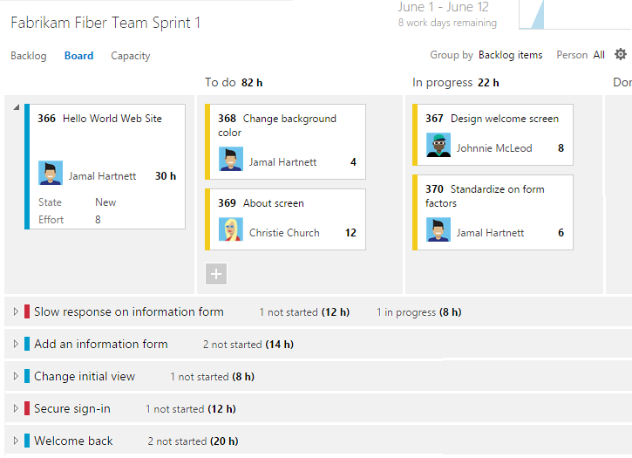
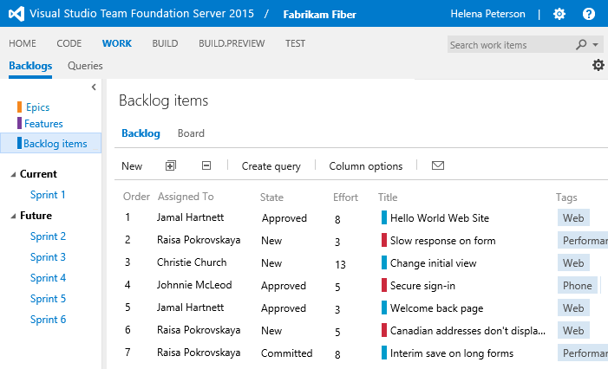
Streamlined Communication
YES:
Backlogs/boards
Notes:
Backlogs and boards encourage collaboration, and ownership of tasks. Security issues and reviews do not produce reports, that produce tasks in a board.

Slide 12
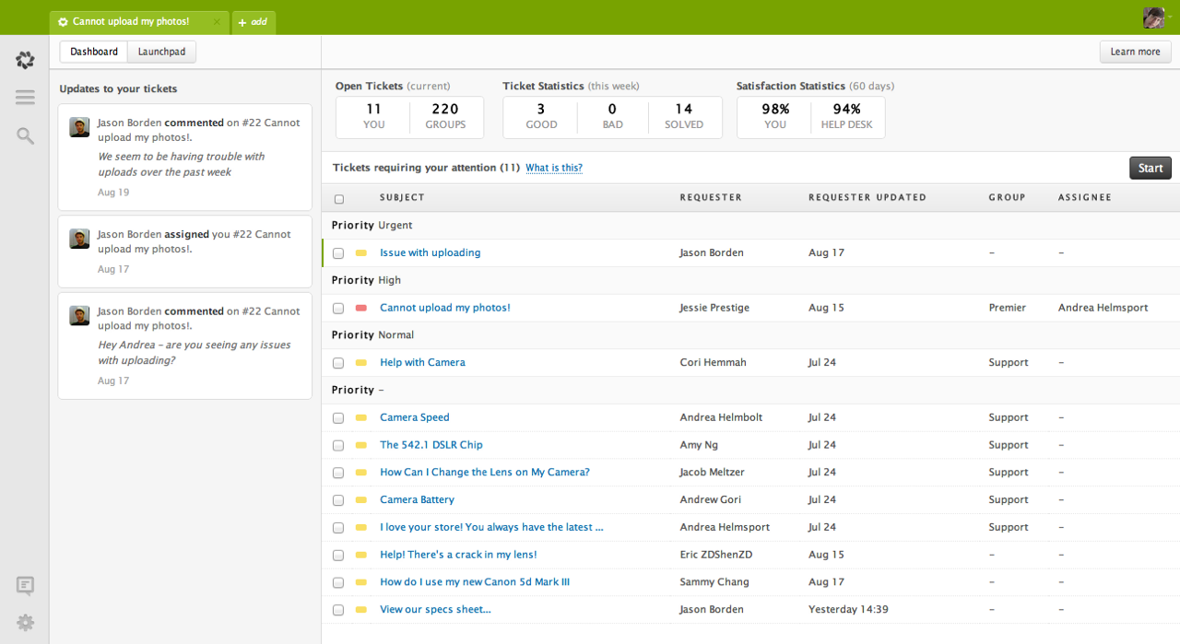
Streamlined Communication
YES:
Backlogs/boards
Support ticketing
Notes:
Don’t underestimate the power of support ticket tools. They encourage better working models, ownership of issues and better customer communication.

Slide 13
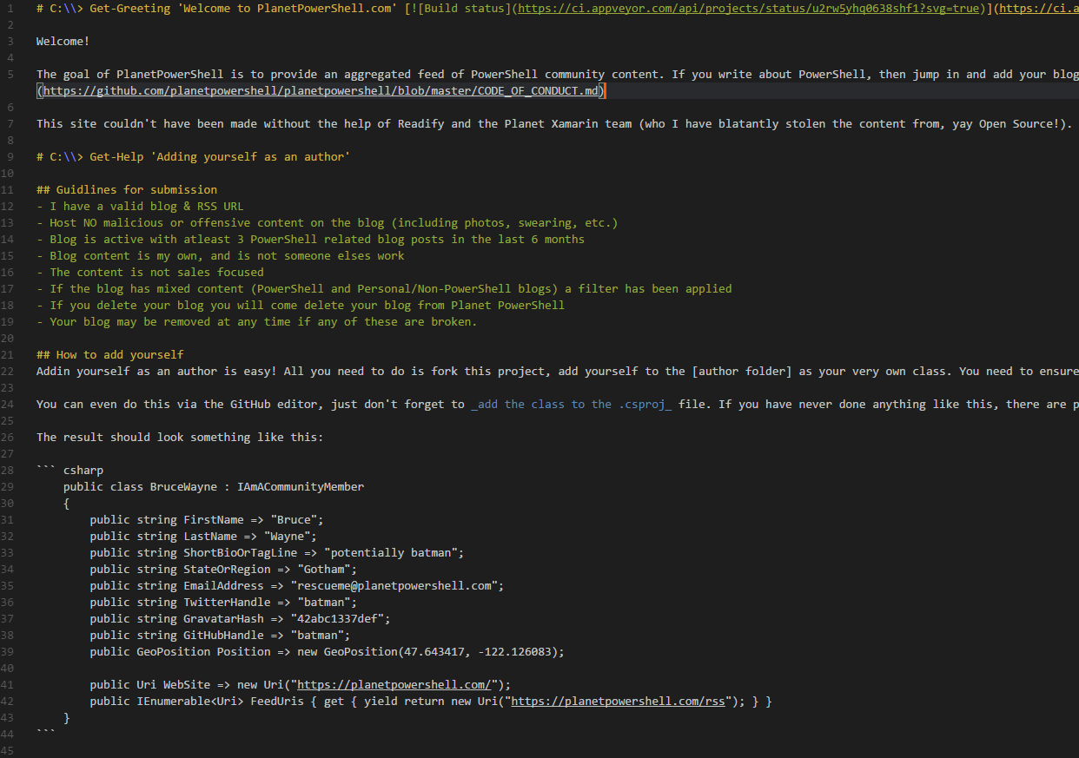
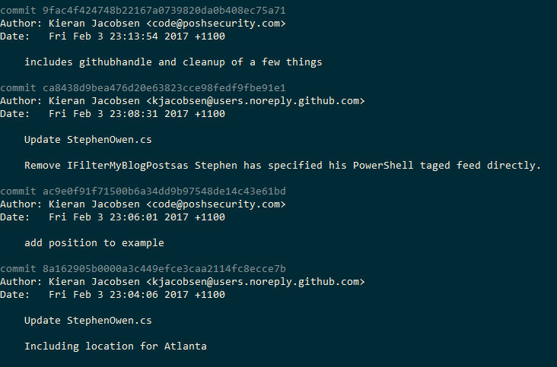
Streamlined Communication
YES:
Backlogs/boards
Support ticketing
Markup and Git
Notes:
Markup when combined with GIT allows for a powerful workflows. We can easily diff files and determine changes and we can have a rich review process via pull requests.
Git encourages collaboration, multiple people can work on a document simultaneous, and then have then changes pulled together, reviewed and approved then pushed out to the wider organisation.

Slide 14
Security As Code
Application Source Code
Azure ARM and AWS Cloud Formation
Server Configuration – Chef, Puppet, DSC
Notes:
So the next big takeaway is security as code. Or as I like to put it, here is all of the code that could impact your organisations security.
Obviously we have application source code, but what about the other parts of your environment?
If your developers are using Azure or AWS, they are probably using templates to deploy infrastructure. Care needs to be taken that these templates are created in a way that the infrastructure they deploy is secure. Does operations review these? What about security?
Server configuration tools like Chef, Puppet and PowerShell DSC are all the rage, but are the configurations they are applying secure? Once again, what is the review process?

Slide 15
ARM Templates
Notes:
So Azure Resource Manager Templates, or ARM Templates for short. Allow us to deploy services within Azure in a repeatable manner. This includes things like storage, networks, addresses, virtual machines, web apps, SQL databases and much more.
In this example, we see a configuration element relating to a Network Security Group, basically this is an ACL. I have taken this from the Azure Quick start templates. This NSG specified that the only traffic allowed to this system is RDP, port 3389. Unfortunately, they have allowed all the internet as a source address, so I guess someone will start brute forcing this box soon enough.
Now I am not surprised by this one, from experience, this is actually better than the majority of templates I see. The majority of templates do not even apply network security groups, resulting in all services, from RDP to SSH to SMB to SQL left exposed to all in sundry.
Do you know if your developers are deploying from examples like this?

Slide 16
PowerShell DSC
Notes:
So let’s take a quick look at another example, this type its PowerShell DSC. This example is snipped of a much larger DSC configuration that all of our servers at Readify comply to. This will disable insecure ciphers being used for HTTPS connections. Imagine the effectiveness if you pushed this out to all of your web servers, or better yet, every server in your fleet?
This is security as code. We are making our environment more secure using code.

Slide 17
Training
We can’t be experts in Dev, Sec and Ops
We need cross pollination of skills
Starts at day 0
Notes:
Training is super critical, we can’t be experts, but we need to have awareness of the other parts of our team. Training needs to start for all areas of IT from day 0, and not just the basics. Developers need to be aware of your organisations of code quality, and this includes security. If you don’t believe me, take a look at Troy Hunt’s blog for more justification on the value of training.

Slide 18
Integrating Security
Notes:
So back we are to the infinite loop that is DevOps. So where should we integrate? The answer is, at every single step along the way. Security is something we need to consider at every step, we use to say security is as strong as the weakest link in the chain, well this loop here is your new chain, lets make sure everything is as strong as it can be.
Automation is crucial here, we need to be able to integrate our security tools with the rest of the continuous build and release pipeline. If your tool needs to be manually triggered, or cannot feed its results back into a backlog, or into a support ticket system, it isn’t going to succeed.

Slide 19
Plan
Integrate security into sprint planning and reviews
Consider security stories early
Notes:
When we plan, we need to involve security in both our sprint planning and reviews. I recommend considering security stories early due to their complexity; you don’t want to leave them till the end of a release cycle.

Slide 20
Code
Training!
Test driven development
Use of the correct tools
Pull Requests
Notes:
Training is crucial to writing secure code, but its also worth considering methodologies like test driven development. Using the right tools is crucial; most IDEs have tools or plugins that will assist developers by highlighting potential security risks. Pull Requests are also crucial, code that contains security issues, doesn’t get merged.

Slide 21
Build
Static code analysis
Dynamic code analysis
Notes:
The security industry has differing views on which is better, I personally think its dependant upon your team and your project. My concern with dynamic code analysis has been ensuring that we have full coverage of the source code. Now people will come to me and say, “but last time we used one of these tools, it generated a billion errors and we were flooded”, well that might be the case, but with DevOps, the focus is on small check-ins, and small code changes. This should reduce the chances of a flood of issues, and if you do get a flood, DevOps and small commits should also assist in highlighting the individual commit that caused the flood gates to open.
If you are using Visual Studio, look at using the Code Analysis tools that it contains. Whilst they are not going to pick up everything, they are a great place to start.
A build that fails its security checks isn’t of high enough quality to proceed further down the pipeline. Ensure that everyone is aware that the expectation is for high quality code to proceed to testing and onwards.

Slide 22
Test
Develop security test cases
Fuzzing
Load testing
Notes:
Automated testing is so critical for a DevOps and a DevSecOps project. Testing is how we ensure that our code is up to scratch and its of quality that we would want to deploy it. When Testing, be it unit testing, or automated UI testing, or even formal manual user acceptance testing, include security test cases, that is cases that can be used to ensure the system is performing securely. A simple example of this might be that if a user was to enter SQL injection into a webform, that the form doesn’t output SQL errors.
Fuzzing is another technical that is becoming popular, it’s the process of sending random inputs to software to spot security holes. A number of vendors are producing not only great fuzzing tools, but ones that allow for automated tests with integration into our build and release pipelines. Microsoft recently announced Project Springfield, a tool its been testing in house and with customers.
Another bit of testing that can be automated, and is so often overlooked is load testing. I can’t believe its 2017, and people still don’t do load testing. Load Testing not only proves that the application infrastructure can handle the load, but it can also help us determine if it can handle more than what is expected, say in the event of an attack. Microsoft includes support for load testing in their VSTS platform.
Once again, if the app fails in testing, it doesn’t proceed.

Slide 23
Release & Deploy
Automated scanning upon deployment
Notes:
When an application gets to the release and deployment stages, we might think there is nothing for us to do; this isn’t the case, at this point, we may have deployed an application into a development or pre-production environment prior to deployment on production. Why not perform an end-to-end vulnerability assessment, scan not just the application but the entire stack, from servers, to databases, to load balancers. This is potentially your first time seeing the application and its supporting elements in its entirety, make use of the opportunity.

Slide 24
Operate & Monitor
Monitor logs
Rescan for vulnerabilities
Track dependencies

Slide 25
Thank You

