Slide 1
Exploiting MS15-034 In PowerShell
Kieran Jacobsen
Technical Lead - Readify
@kjacobsen – poshsecurity.com
Notes:
Hi everyone, my name is Kieran Jacobsen, I am a Technical Lead at Readify. Tonight I am hear to talk about working with TCP connections and how we can use this to exploit the vulnerability described in MS15034.

Slide 2
‘Remote Code Execution’ -in HTTP.SYS
Notes:
So who here knows about MS15034, can I just see some hands?
So the bulletin has this for its brief description: “A remote code execution vulnerability exists in the HTTP protocol stack (HTTP.sys) that is caused when HTTP.sys improperly parses specially crafted HTTP requests. An attacker who successfully exploited this vulnerability could execute arbitrary code in the context of the System account.”
Wow, that doesn’t sound too good. Remote code executing as the system account, that doesn’t sound good, or is it?

Slide 3
If the bad guy can execute code on your box, it isn’t your box anymore.
Notes:
A remote code execution vulnerability, or RCE, allows a successful attacker to execute the code of their choosing on your system. Now as the old security adage says, if the bad guy can execute code on your box, it isn’t your box anymore.
Now when we discuss RCEs, there is one important factor that we should consider. Authentication. 15034 is an unauthenticated RCE, and this means that an attacker does not require any previous valid credentials to be able to perform a successful attack. These sorts of vulnerabilities are quite prevalent, and are always a serious risk to our systems.

Slide 4
HTTP.SYS is everywhere
Notes:
One thing that came out about this vulnerability, is that a significant portion of the community, both infrastructure and security community, don’t quite understand what HTTP.SYS is, and what it does. HTTP.SYS is a server protocol stack, and was first introduced by Microsoft back in Windows Server 2003. It was Microsoft’s response to the scrutiny that had occurred over its security practices in light of events like the Code Red worm.
It was also Microsoft’s aim for this protocol stack to allow for faster, lightweight and more securely deployed web server environments.
The first place HTTP.SYS appeared was obviously, IIS, however it can now be found in a wide range of places. Direct Access, the SSTP VPN, the Web Application proxy and later versions of ADFS and SSRS. Mostly importantly however, Windows Remoting is based upon HTTP.SYS.
At this point, you should be getting just a little bit worried. I am describing an unauthenticated remote code execution vulnerability across a wide range of systems deployed in your environment, some of which are public facing. Also, consider how many systems have WinRM publicly exposed, and you wouldn’t be blamed for thinking the whole situation is just a little bit terrifying.

Slide 5
IIS Kernel Caching module
Notes:
Thankfully, this vulnerability isn’t quite a simple as it first looks. This vulnerability requires the presence of the IIS Kernel Caching module and that is typically only found in IIS installations. Most importantly, WinRM doesn’t use this module.
At this moment, you can start to relax a little.
Now the security community has always be quick to reverse engineer patches like this, and in this case, they were exceptionally fast. It was quickly discovered that the issue was in the way HTTP.SYS parses the RANGE HTTP header in a HTTP request. If the range specified was suitably large, this could result in a buffer overflow.
Just as a matter of knowledge, the range header allows a client to request only part of a file or entity. Say we just wanted the first 100 bytes of that jpg image, well, we could use the range header to specify that.
Now it turns out, RCE from just this header alone, isn’t easy.

Slide 6
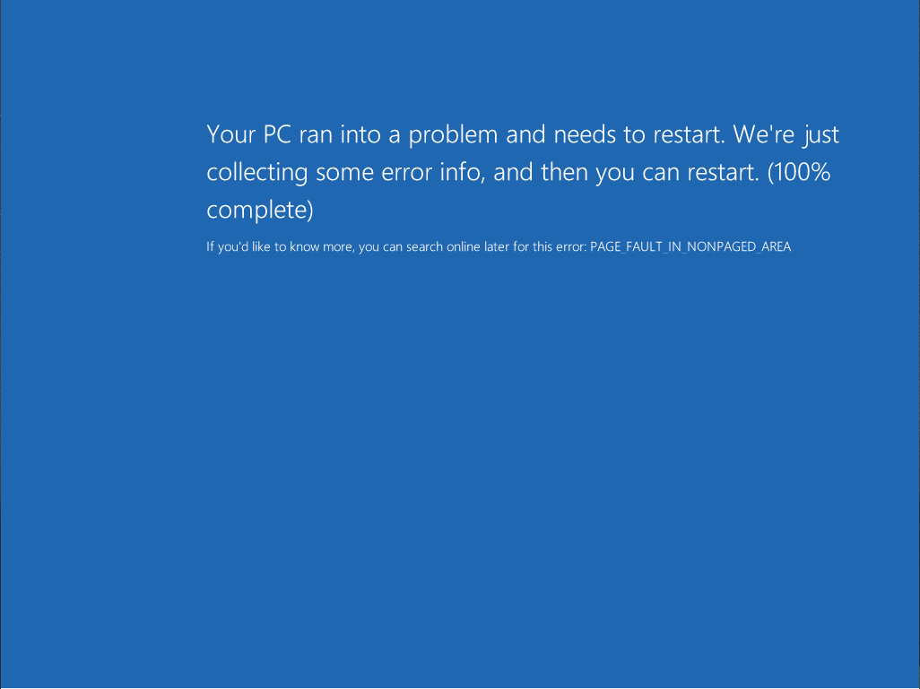
Notes:
This, thankfully is the worst thing that an attacker can do to a vulnerable system. Whilst there was some claims that there were ways of using this vulnerability to actually execute code, most of the time, the result is an instant bluescreen of death like this one. A denial of service vulnerability like this one is definitely nowhere near as bad as remote code execution, but no matter what, if someone is doing this to your servers, you are going to have a bad day.
Any attack, which can be performed easily, anonymously and requires little to no technical knowledge or ability that results in a denial of service, is pretty serious.

Slide 7
Are we vulnerable?
Notes:
So whenever you read about a vulnerability, or your CISO, CIO or CTO read about one, the first thing you will be asked, or want to know, is are we vulnerable?
Now there were websites that you could use to check if a server was vulnerable, but that isn’t something we would all be comfortable with. There were perl and python scripts as well, and for those who know metasploit, there was a module for that.
But I wanted to use Powershell.
Let’s take a quick look at using PowerShell to test for the vulnerability.

Slide 8
Request -> Response
Notes:
There are two things that make working with TCP connections in PowerShell wonderfully simple. The first is the fact that HTTP is a text based protocol. Meaning that we will send some strings as a request, and the server responds back in kind. The other thing that makes the whole thing easy is the .Net framework. The .Net framework will take care of almost everything at the TCP layer, leaving us with just the HTTP protocol to worry about. All we need to do is make an appropriate HTTP request, and the server should respond with what we want. So what does that request look like?

Slide 9
GET / HTTP/1.1 Host: google.com Range: bytes=0-18446744073709551615 Connection: Close
Notes:
So this is an average HTTP request, however it has been modified to exploit the MS15034 vulnerability.
The request starts with our METHOD, in this case, we want to get the document root as you can see. We are also specifying that we will be using the HTTP 1.1 protocol. Then we have the HOST header, this is mandatory in HTTP 1.1 and lets a server know which website we actually want to browse. Next up is the pesky RANGE header. Notice that massive value? That is a widely accepted value for testing if a server is actually vulnerable. Changing the start of the range to 18 triggers the bluescreen. Finally, I am specifying the optional header CONNECTION and specifying CLOSE. Normally a server will keep the TCP connection with the client open after serving a request, however in this case, I am happy for the connection to be closed, and have said so via this header value.
Each header element needs to be separated by a carriage return and a new line, and we need to finish the request with empty line as well.

Slide 10
GET / HTTP/1.1`r`n Host: google.com`r`n Range: bytes=0-18446744073709551615`r`n Connection: Close `r`n `r`n
Notes:
So just to highlight, if we specify those carriage returns and new lines, we get something like this.
I just wanted to point out that the escape character for PowerShell is the backtick, and not the forward slash. If you are working of example online, maybe those written in c#, they will probably use forward slash r forward slash n, if you don’t change this when moving to PowerShell, you might end up sending a garbage request to the server.
Also note that there is an empty or blank line at the end. This is to indicate to the server that our request is complete.

Slide 11
Streams
Notes:
The next thing we need to understand is how to send and receive information over our TCP connection. When we connect using the TCP client, it provides us with something called the TCPStream. We send our requests, and recieve the responses over this stream.
We can either write and read directly to the stream, however we will need to encode our strings to either ASCII or UTF byte arrays; or we could use the StreamWriter and StreamReader objects from .Net. The choice is yours with this one, I have used both methods and they are equally reliable. Today I will show you the use of StreamWriter and StreamReader, overall I found these to be a bit easier and the code produced seems to be easier to understand.
There is one other stream that can be used, the SSLStream. The SSLStream makes the process of connecting to SSL services much, much easier. Implementing SSL requires a change to one line of code, and an additional line to verify the server’s certificates. Piece of cake! I really did expect this to be much harder, and was utterly astounded at how easy Microsoft has made it.

Slide 12
Working with TCP
Notes:
So lets take a look
<code demos>

Slide 13
MS15034.psm1
Notes:
So as part of my work on the MS15034, I developed a PowerShell module that allows us to firstly test if a server is vulnerable, and secondly invoke the denial of service. I have made this code publicly available, and have been surprised at its popularity.
Let’s take a look at the module in action.

Slide 14
More Information
My Website – http://poshsecurity.com
Twitter - @kjacobsen
MS15-034 Module – http://github.com/PoshSecurity/MS15034
Microsoft Security Bulletin - https://technet.microsoft.com/en-us/library/security/ms15-034.aspx
Notes:
That is all for me tonight, if you want more information, my website is PoshSecurity.com. I write mostly about security, PowerShell and automation. I will put up the slides and demos from tonight’s presentation on there in the coming days. You can contact me on my site, or I can be found via Twitter, @kjacobsen.
The module I developed for MS15-034 can be found on GitHub, and I have also put up a link to the original Microsoft KB.
Thank you all for listening to me tonight. Does anyone have any questions?

