Slide 1
Secure Azure Deployment Patterns
Notes:
Hi Everyone, thank you for coming to the Azure Global Bootcamp 2018 in Melbourne. I hope that you all have a wonderful day. Today I am going to talk to you about how we can secure our azure deployments, with a focus on App Services, SQL, Storage and virtual machines.

Slide 2
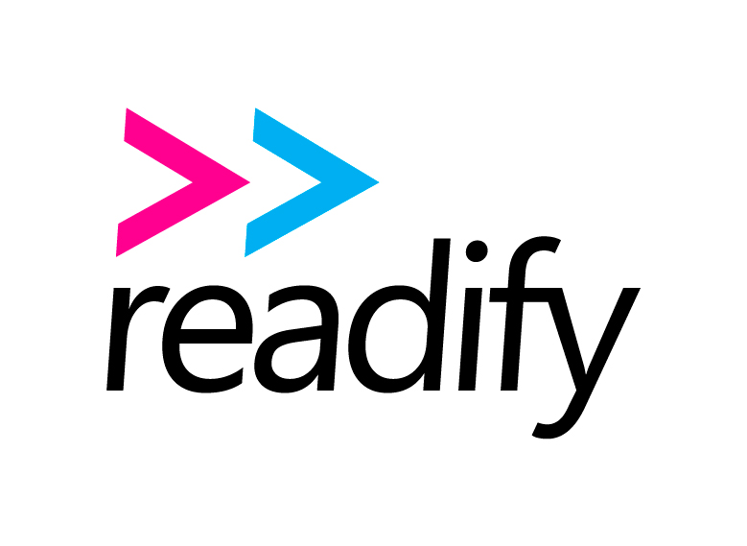
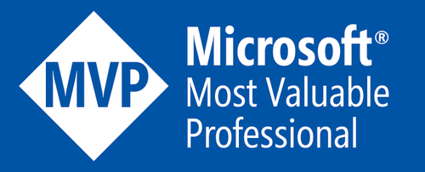
Kieran Jacobsen
Microsoft MVP – Head of Information Technology @ Readify
Notes:
My name is Kieran Jacobsen. I’m a Microsoft MVP for Cloud and Datacenter Management, and the Head of Information Technology at Readify.
I blog at PoshSecurity.com and an the founder of Planet PowerShell, an aggregator of community written PowerShell content.

Slide 3
A Big Thanks To Our Sponsors:
Global Sponsors
Microsoft
CloudMonix
myGet
Cerebrata
Opsgility
JetBrains
ServiceBus 360
Melbourne Sponsors
AGL
Readify
Kloud
SixPivot
PTGR
Notes:
I wanted to give a big thanks to all of our sponsors, as one of the organisers, I know that we couldn’t have made today what it is without their support. Big thanks to Microsoft, AGL for the space, Readify, Kloud, SixPivot, PTGR and the global sponsors.
At Readify we are always looking for talented Developers, Data Analytics Experts and DevOps practitioners. If you are interested in what opportunities we might have at Readify, feel free to come and have a chat.

Slide 4
“Flying by the seat of the pants must have been a great experience for the magnificent men in the flying machines of days gone by, but no one would think of taking that risk with the lives of 500 passengers on a modern aircraft.”
Notes:
So I want to start the session with a quote from Dr Chris Harding from The Open Group. “Flying by the seat of the pants must have been a great experience for the magnificent men in the flying machines of days gone by, but no one would think of taking that risk with the lives of 500 passengers on a modern aircraft.” Dr Chris then goes on to say that modern enterprises should not have to take that risk either, that they need to develop cloud metrics and ROI models, but I also like to think he was talking about our approach to the security of our applications in the Cloud.

Slide 5
A Typical Web App
Full of lies and security vulnerabilities
Notes:
Let’s look at a typical situation that I often come across. We have a customer who runs a popular website, Supercar Showdown. They have come to us to ensure that it is secure and compliant. They tell us the application was put together by a friend and is hosted on Azure. They ask if we can help.
How do we even start? Well a good start would be to look at the application and determine some of the risks it faces.

Slide 6
The Web App
Azure App Service
Azure SQL
Azure Storage
Notes:
The website follows a very familiar patter in Azure deployments. There is an Azure App Service running the site, the site uses Azure SQL to store content. The customer also uses Azure storage accounts to host some other information.
The challenge when we deploy cloud applications to PaaS offerings, is the responsibility for security is firmly placed with the developer. The security of the application relies heavily on those who are writing the code and deploying the resources to get everything right. There really isn’t room for failure. A single vulnerability can lead to a breach in the entire application.
The application today was written by Troy Hunt to be deliberately insecure. There are also sorts of security vulnerabilities. It is a great example of an application built with good intentions, but containing many typical security failings.
As you can see, I have the masked hoodie figure, the typical media portrayal of a hacker. Lets for a moment pretend that they have found the website, what could they do to it?
Let’s take a look.

Slide 7
Demo – A Typical Deployment
Notes:
<switch to browser – http://typicaldeployment.azurewebsites.net>
Here we have the app supercar showdown. The app lets users register and then vote on what cars they like! We can select the leader board, pick a car and vote for it. <show them voting>
And this is what it looks like in Azure <switch to portal>. We see a single resource group with everything you expect. App insights, SQL server, App Service plan, app service and an SQL database. I deployed this by simply going “Create a resource” and selecting the “web + SQL” option. I then deployed the site using VSTS.
The hooded hacker found the site, had a quick look around and discovered an SQL Injection vulnerability in the voting API. They want more, so they are doing to use a tool called sqlmap. Let me switch across to my Kali Linux on WSL. <switch window>.
Let’s run this command <run: sqlmap -u http://typicaldeployment.azurewebsites.net/make/3?orderby=supercarid --dump --dbms='Microsoft SQL Server' -T dbo.UserProfile -D typicaldeployment --threads=10 --start=1 --stop=5>
The hacker had already performed some initial recon either manually or with automated tools, this command is going to extract the first 5 rows from a table called UserProfile from the database Supercar Showdown uses. In a few minutes a white table should appear with that data. Pay attention to what you see!
Let’s backtrack for a second and talk about SQL injection. SQL Injection is a vulnerability in applications where an attacker can force the application execute SQL queries of their choosing. It is an extremely common vulnerability in applications, particularly web applications, and is ranked as the number one application vulnerability in the OWASP top 10.
Tools like sqlmap are extremely popular in groups like anonymous as they require no technical knowledge. There are thousands of guides and youtube videos to show you how to use it. It even has a wizard mode to help you get started with hacking. I have seen cases of 13 and 14 year olds using sqlmap to attack websites.
And look at that, perfect timing. As you can see, we have the first 5 rows of the table, including their email address, first and last name, and their password in plain text. See how easy that was?

Slide 8
Securing Azure SQL
Protect the data!
Notes:
We now know that the application is vulnerable to SQL injection, I think the best place to start would be to review the security of the Azure SQL Server and the database.
The database behind Supercar Showdown contains all of the data for the application, so the client is extremely worried about the database being hacked and loosing data.

Slide 9
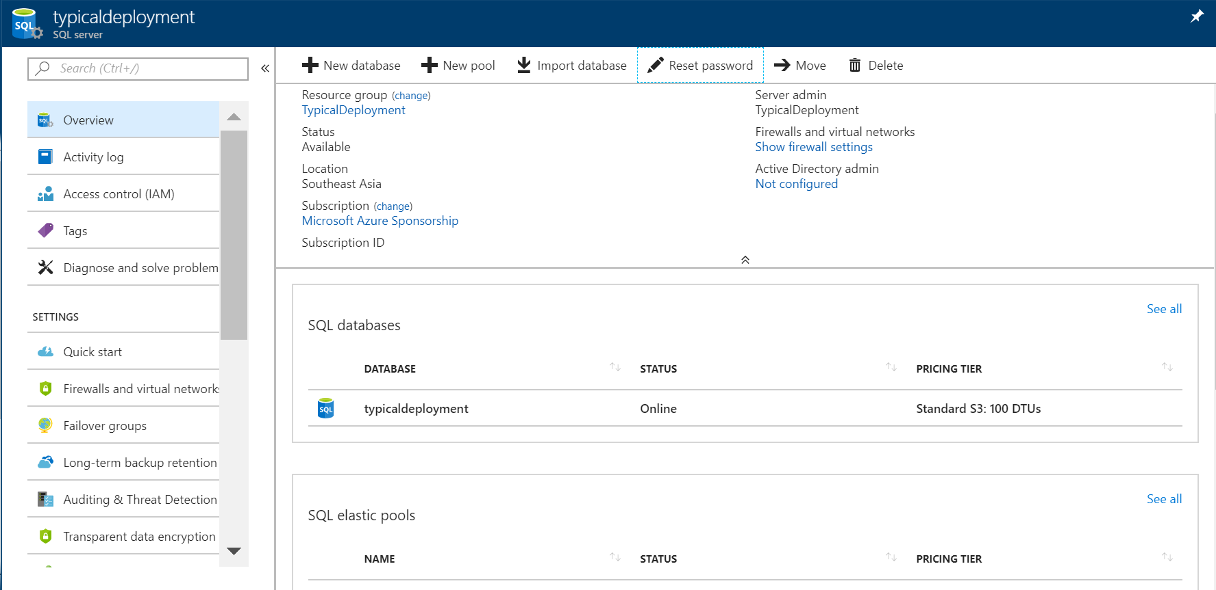
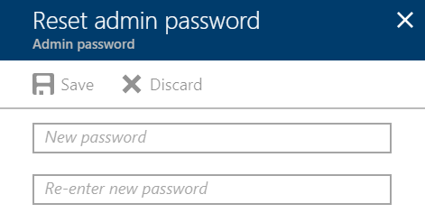
Admin Password
Notes:
Let’s start with the first and most obvious item.
Internet criminals love nothing more than to find database instances with weak credentials. This isn’t just about Azure SQL, but MongoDB, Hadoop, Elasticseach and MySQL. In early 2017 we saw ransomware campaigns where criminals would either download, encrypt or delete data from insecurely protected database and then try to extort money out of their victims.
No matter what you deploy, Azure SQL or anything else, always ensure that the passwords you use are long, strong, random and unique.

Slide 10
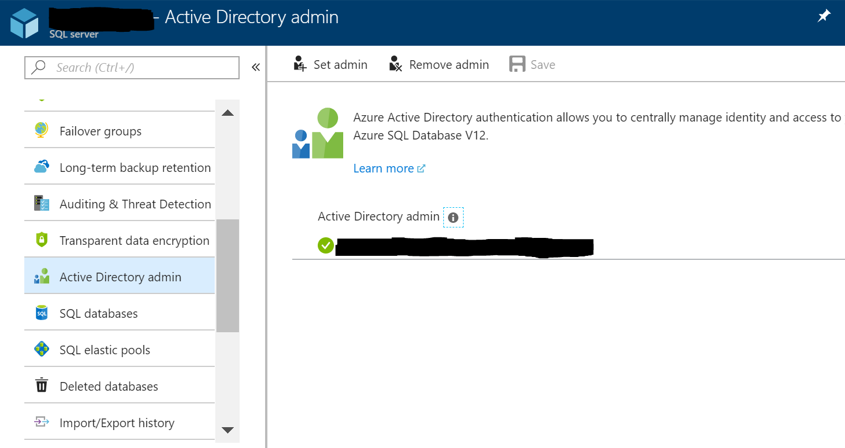
Azure AD Authentication
Notes:
SQL Server supports two types of authentication, SQL and Azure AD. Using Azure AD authentication is similar to Windows Authentication on SQL Server. It offers us centralised identity management and more opportunities to audited access.
You can enable any Azure SQL server to use AAD auth through the portal or ARM, and you can use both SQL and Azure AD accounts on the same server. You can use Azure AD service principals to delegate permission to applications and things like VSTS. Combine this with Conditional Access to enforce MFA when admin users want to connect to administer the database.
Using AAD auth will require some updates to your SQL connection strings.
One thing is that dot net core doesn’t support ADAL which you need to support AAD auth. So if your app uses dot net core, you will not be able to connect.

Slide 11
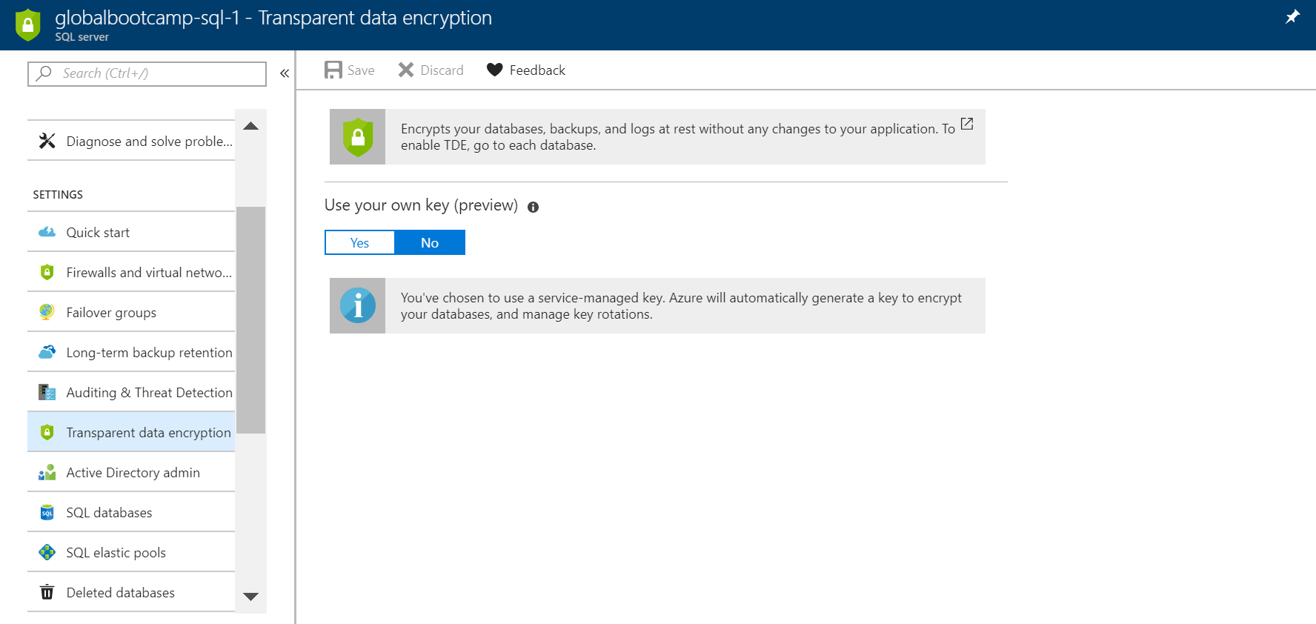
Transparent Data Encryption
Notes:
We should encrypt our data when it is in transit and at rest. Transparent data encryption or TDE will encrypt our SQL databases, transaction logs and backups. The best part is that you don’t need to make any changes to your application.
You can have Microsoft manage the key or bring your own and store it in Key Vault.

Slide 12
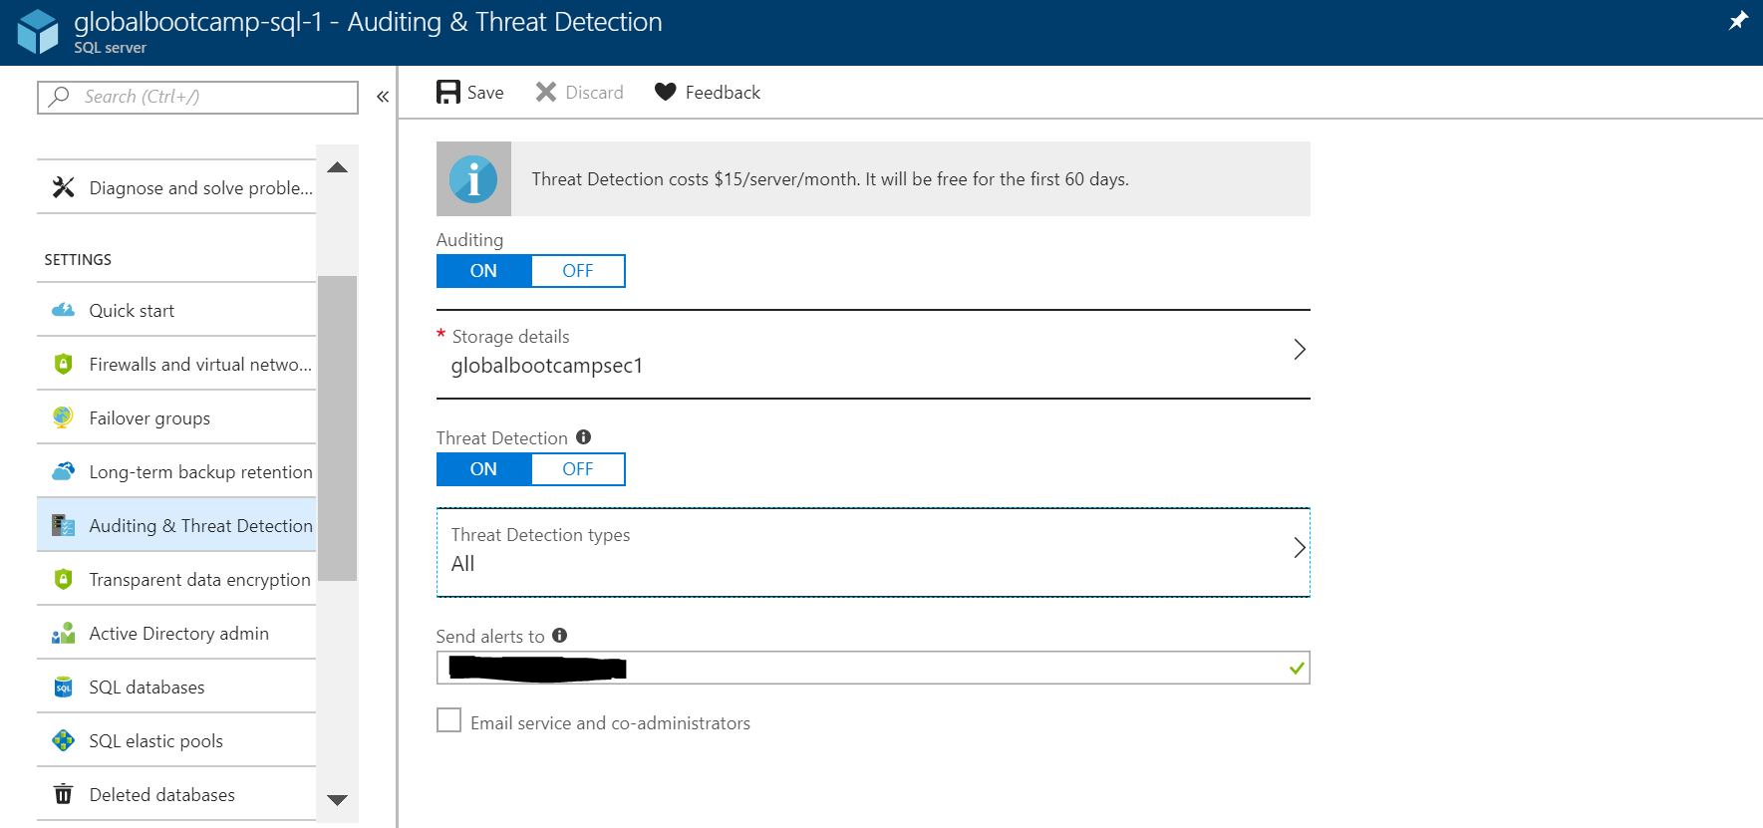
Auditing and Threat Detection
Notes:
Auditing is a critical aspect to all security and infrastructure operations. Auditing allows us to discover who connected to a server. Auditing is super simple to enable. Open the server, specify a storage account and a retention period, and you are good to go. You can actually share the storage account across subscriptions, but you cannot share across regions.
Threat detection in this situation is really important. After all, the client has asked us what they can do to protect their app. While everything else we have looked at is free, Threat detection costs $15 per server per month. Threat detection will generate alerts for SQL injection and suspicious client logins. Unfortunately it can only alert us, it cannot do anything to stop the threats. Alerts will be delivered via email to a specified list or to service and co-administrators. Threat Analytics alerts are also made available in Azure Security Center.

Slide 13
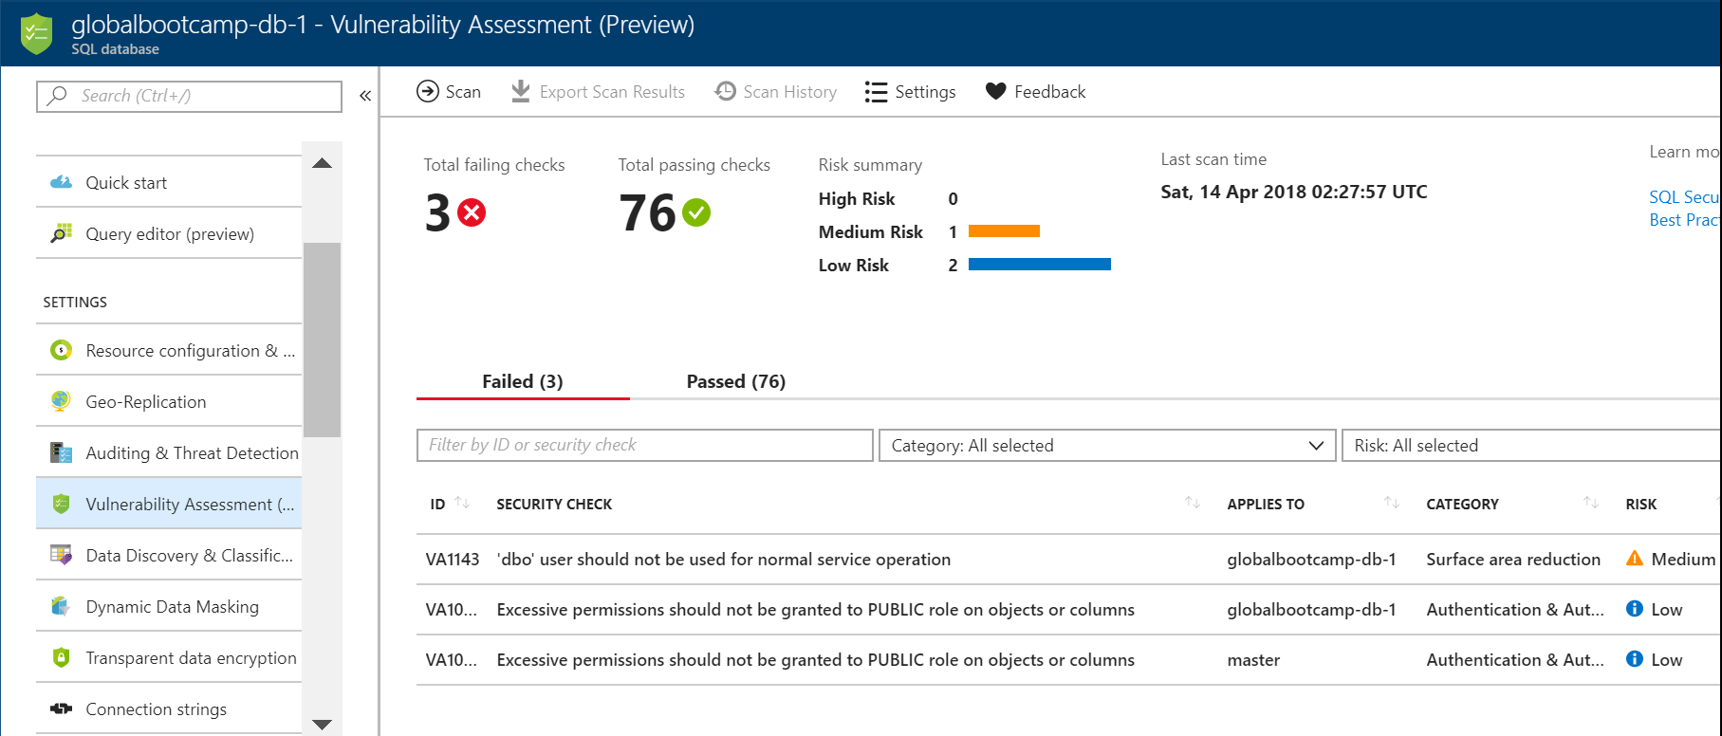
Vulnerability Assessment
Notes:
Vulnerability assessment is a new feature that is currently in preview. It allows us to configure scans that will discover and track potential database issues. Issues are displayed in a very easy to understand format and include actionable steps to resolve any detected issues. Remediation steps include SQL queries to resolve the issues. You can also customise your security baseline to meet your organisations needs.
This is a great tool to help you meet compliance needs and to monitor environments where it is hard to track all of the changes. Scans occur on a scheduled basis, they are extremely lightweight and safe, using only read-only access. The rules are based on Microsoft’s best practices, and focus on the security issues that present the biggest risks to your database and its valuable data. These rules also represent many of the requirements from various regulatory bodies so you can meet their compliance standards.

Slide 14
Other Considerations
Data Discovery and Classification
Dynamic Data masking
Failover Groups & Geo-Replication
Long-term backup retention
Notes:
There are a few other things that quite a few people don’t consider when deploying Azure SQL. These are not directly related to the security of Azure SQL, but they could impact compliance, so you need to be aware.
<<<<if time>>>>>
Data Discovery and classification is currently in preview and provides advanced capabilities built into Azure SQL Database for discovering, classifying, labeling & protecting the sensitive data in your databases. This help you make decisions on what security protections you might need as well as help meet data security and privacy standards. Azure SQL Auditing has been enhanced to include a new field in the audit log that will contain the sensitive label for actual the data that was included in a query.
Dynamic data masking allows us to control what non-privileged users see when they look at sensitive data. Dynamic Data Masking will identify database columns that contain sensitive information and recommend potential masks. We can then apply those masks to the row. For instance in the Supercar Showdown, we might mask the users email addresses. Administrators can still see the values, but someone from the sales team will be un able to.
You can’t talk security and not think about availability. Azure SQL is highly available as it is, however with Failover Groups and Geo-Replication we can ensure that our databases will be available even in the event of an entire Azure Region becoming unavailable.
Finally, make sure you keep backups. Databases that are basic tier keep backups for 7 days, standard and premium keep backups for 35 days. Most legal and compliance requirements is measured in years. Do yourself a favour and setup long term backup retention.

Slide 15
Azure App Gateway
Filtering out the bad web stuff
Notes:
Now that we have implemented some basic Azure SQL controls and are getting alerts when SQL injection takes place, the client asks: “Well can’t we do something to actually block SQL injection?” and “How do we block all those other attacks?”
Once again, Microsoft has thought of a solution, Azure App Gateway.

Slide 16
App Gateway
HTTP/HTTPS load balancer
Web Application Firewall (WAF)
SSL offload
Traffic Manager integration
Notes:
How many of you have used the Azure App Gateway? <wait for hands>
App Gateway is a HTTP, load balancer, unlike the Azure Load balancer, it was designed to be HTTP aware, providing more control of web application traffic.
App Gateway offers a Web Application Firewall, WAF, in its medium and large tiers. Web application firewalls help secure your web applications by inspecting inbound web traffic to block SQL injections, Cross-Site Scripting, malware uploads & application DDoS and other attacks.
App Gateway is a little bit basic compared to other vendor offerings, but has two rule sets, each with around 100 rules. You can disable rules that might be causing issues. Unfortunately you cannot write your own rules right now.
App Gateway also supports SSL offloading, depending upon your organisational needs and compliance requirements, this might be something of interest. App Gateway is also tightly integrated with other Azure services like Traffic Manager.

Slide 17
Notes:
Some of you are probably thinking, “I thought WAFs were for those checkbox compliance security types?”, and the answer is, yes, you are partially correct. Here’s the thing, if your Azure project needs to get past a check box compliance person, App Gateway will help you!

Slide 18
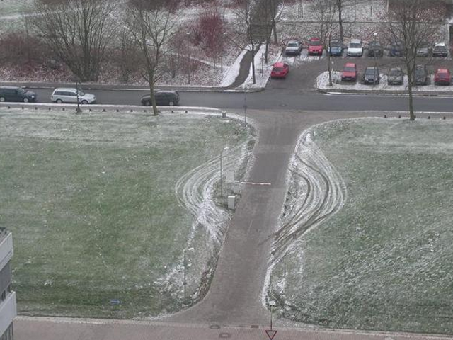
Notes:
WAFs in some parts of the security industry and developer community have a bad name. Stories of their deployment causing widespread outages, or having their rules disabled one by one until they service no purpose. A skilled attacker could still bypass the protections, and I don’t think for one minute that having a WAF excuses developers for writing bad code. I see a WAF as an extra level of protection, there in case a developer had a bad day and accidently introduced a vulnerability.

Slide 19
Deployment Models
PaaS
IaaS
Notes:
In the past, App Gateway only supported protecting App Service Environment and Virtual Machine workloads. Things have changed, and you can now deploy an App Gateway to protect an App Service that isn’t deployed on an ASE. This is a massive improvement, and allows the protections to be provided to more applications.

Slide 20
Demo – Azure App Gateway
Notes:
Let’s go back to our hooded hacker for a moment.
I have another instance of the Supercar Showdown, this one is behind an App Gateway. Firstly I want to show you the WAF rules. <switch to Azure portal, open app gateway switch to WAF tab>
You can see the firewall status is enabled and set to prevention. I am using the newer OWASP 3.0 rules. If I check Advanced Configuration <check> here are some of the attacks it will detect. We can see SQL Injection, cross site scripting, even attacks against PHP can be filtered and blocked. Lets uncheck the box, <uncheck> and switch across to Kali. <switch to kali>
Let’s see what happens now when I run the same sqldump command but with its address.
<run: sqlmap -u http://secureapp.ase.umbrellacorp.info/make/3?orderby=supercarid --dump --dbms='Microsoft SQL Server' -T dbo.UserProfile -D typicaldeployment --threads=10 --start=1 --stop=5>
Now it is going to run through the same steps, but this time we should see a very different response.
<wait for it to finish>
Now we see that it has stopped with a critical error, “all tested parameters do not appear to be injectable”.
<<< if more time >>
We can also try to increase the aggressiveness of sqlmap to see if we can get something out.
<run: sqlmap -u http://secureapp.ase.umbrellacorp.info/make/3?orderby=supercarid --dump --dbms='Microsoft SQL Server' -T dbo.UserProfile -D typicaldeployment --threads=10 --start=1 --stop=5 –test-only –technique=BU –tamper=space2comment >

Slide 21
App Service Environments
A very private App Service experience
Notes:
So we have stopped the hackers, but now the client has come back with some more requests. The client needs to meet some industry compliance, as part of that, they need to ensure that their applications are isolated from other organisations and users in Azure. How can we do that? With an Azure Service Environment.

Slide 22
Why use ASE?
Virtual Network connectivity
Private App Services
Static outbound IP and filtering
Massive Scaling
Separation and isolation
Notes:
Why should we use App Service Environments?
ASEs are connected to a virtual network and can be made available publicly or privately. The option of having the ASE available privately opens up some interesting options, as you could now have an App Service available to just your internal network. In my environment I deployed the ASE as private network only. If you want your app services to be deployed with close connectivity to IaaS resources, or even on premises resources, then an ASE might be for you. Yes you can use hybrid connections or point-to-site VPN, but there are some situations, where they do not work or are not suitable.
ASEs provide a static public outbound IP address. While this doesn’t sound important, it could be required for some integration scenarios. You also have the ability to control what outbound traffic leaves your application using Network Security Groups.
Scale is another reason to chose an ASE. You can scale a single App Service Plan to support 100 isolated worker instances. If your application needs that level of scalability, then chose an ASE.
The big reason to chose an ASE is when you need to ensure separation and isolation of your app services. If you have performance, privacy or regulatory requirements and need to ensure that your workload is isolated from everyone else, then you need to deploy an ASE.

Slide 23
ASE Concepts
App Service
App Service
App Service
App Service Plan
App Service Plan
App Service Environment
Azure
Notes:
Microsoft did a great job simplifying some of the complexity with ASE version 2. Let’s start with some basic concepts.
We start by deploying an App Service Environment. As part of the deployment we need to specify the virtual network, DNS name, and other basic settings. Microsoft will then deploy some support infrastructure: load balancers, publishing services, some api components etc.
Once you have defined your ASE, you can then create App Service Plans. App Service Plans that you deploy within your ASE, these run on Isolated Workers. Much like any other app service plan, you can pick how many isolated workers you want, their size and how they scale. You can create multiple App Service plans within an App Service Environment, with different sizes and numbers of workers. You can create multiple app services can run in a single App Service Plan.
Before you race out to deploy an ASE, you need to seriously consider the cost associated. These things are not cheap. To start with, there is a flat fee charged for the deployment of an ASE. This fee is based upon the region you are in and the initial configuration. You will pay somewhere from $1000 to $1700 per month just for your ASE.
You then need to pay for your App Service Plan workers. Isolated workers start at around $219 to $450 depending upon region for an I1 through to $800 to $1800 per month for an I3. My demo environment is costing me around $1400 per month to run, and when this session ends, I will be deleting it as quickly as possible.

Slide 24
Demo – App Service Environment
Notes:
I am not going to show you the creation of an ASE, that actually takes quite some while. What I do want to show you is how easy it is to create a new App Service Plan, and some of the management experience.
<open portal and open the ASE>
So I am just going to open my app service environment. There isn’t much to see here. Some basic configuration, alerts, and I can see the apps and app service plans running within this ASE.
Let’s pretend we were going to create another app service plan using the portal, <click home then App Service plan shortcut>. If I hit create, I can now see there is a new option to select in Locations. Our ASE will be listed alongside the Azure Regions. <click on the location list>
Now let’s look at pricing <click the tier>. You can see that things are pretty pricey, but you really do need to look at what you are getting for that price.
Next, lets see an app service. <select home then the app service>. This all looks pretty normal right? Things to think about is when we go to custom domains, we don’t have an azurewebsites.net url, instead we have the custom one we specified in the ASE creation.
One trick is accessing Kudo, and I don’t have time to show you today, but you will need to grab a copy of the publishing credentials to access Kudo, it isn’t an integrated authentication experience.

Slide 25
Restricting Inbound Access
Let’s build a wall
Notes:
So the client is really happy, their site is more secure and they have an App Service environment that isolates their application. Their next question, can we restrict who connects to Azure SQL and our storage accounts?
Yes, yes we can.

Slide 26
Notes:
From the late 1960s to the late 80s, there was a public service announcement on American TV that would ask parents “do you know where your children are?” I have my own version of that, “Do you know who can connect to your server?”.
It isn’t just servers, do you know who can connect to resources like Azure SQL?

Slide 27
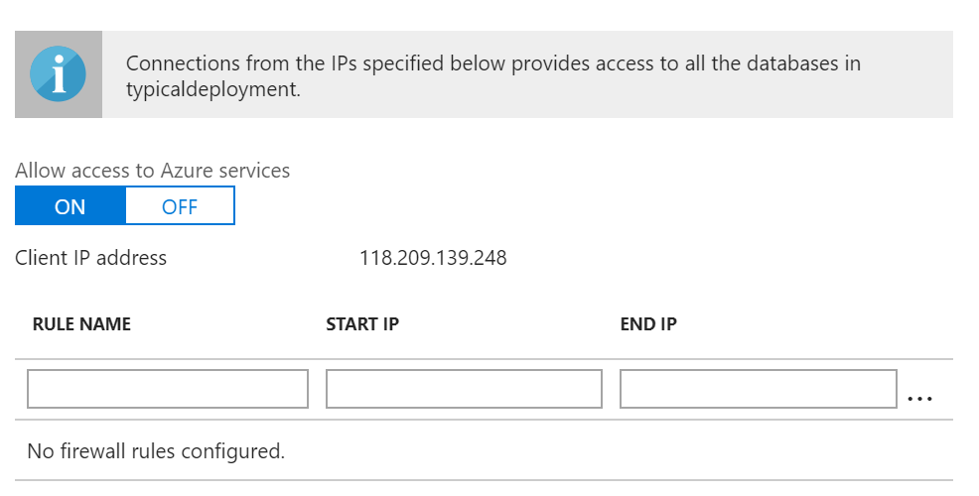
Notes:
So how many of you have configured access to their Azure SQL Server using this screen in the portal? <hands>
Do any of you audit the rules listed here? <hands>
Can anyone tell me how the “Allow access to Azure Services” toggle works? <ask>
<ANSWER>Correct, this allows all Azure services to connect to your server instance, not just those in your subscriptions, but all Azure services to connect.
Has anyone wondered how many addresses this? Does anyone want to guess?

Slide 28
13,324,335
Public IPv4 addresses in Azure
Notes:
As of Monday, Microsoft Azure has a bit over 13 million public IPv4 addresses. Across over 2 thousand subnets. When you enable the Azure Services in your SQL server firewall, that is the number of addresses you are potentially allowing to connect.
That’s ok you say. Kieran, I am just going to create a script that restricts the firewall rules down to a single region, or maybe a set of regions. That way it will be a much smaller amount of IP addresses!

Slide 29
392,192
129,531
Australia East + Australia Southeast
China East + China North
Notes:
Sure you can do that, but in the two public regions here in Australia, we have almost 4 hundred thousand addresses.
For those of you still worried about Chinese hackers, there is 130 thousand addresses in the two China regions.
Are you still comfortable with that switch now?

Slide 30
Virtual Network Endpoints
Azure resources can be secured to your virtual network
Optimised traffic routing
Less management overhead
No changes to applications
Notes:
Service endpoints are pretty new to Azure, and bring some powerful and very requested functionality. Endpoints extend your virtual network address space and identity to your Azure services. You can secure critical azure services resources so they can only be accessed from your virtual network.
This is a direct connection to, unlike previously where traffic from a virtual machine to Azure SQL followed your network routes and any forced-tunnelling you might have. Endpoints take traffic directly from your network to the service. They don’t pass through any NAT or gateway devices.
In the past you would often use reserved public IP addresses in your virtual networks to secure access. With endpoints you don’t need to manage these or any associated firewall rules that you might have previously managed.
Another awesome thing is that you don’t need to change how you connect to resources. Your SQL connection strings will remain the same.
Right now you can configure virtual network endpoints with Azure Storage, SQL databases and SQL data warehouse.

Slide 31
Beware
Endpoints don’t work for App Services over point-to-site connections
Some services will stop when removing “Allow all Azure Services”
Notes:
There are two issues you need to beware of when using Virtual Network Endpoints.
Endpoints will not be accessible to App Services if they are connecting to the virtual network using point-to-site connections. They will only work for App Services deployed in an ASE.
You should also be aware that when you remove, or disable the “allow all azure services”, some SQL database features may not function. These include the Import Export Service, Database Query Editor, Database auditing to Azure Tables and the Data Sync service.

Slide 32
Demo – Virtual Network Endpoints
Notes:
For my last demo today, I am going to show you virtual endpoints.
<swtich to azure portal> Let’s take a look at a Azure Storage Account <select storage account> if we go down to Firewalls and virtual networks, we can see that access is only allowed from selected virtual networks.
Let me show you a quick gotcha, if I select files <select files>, we see an error. That’s because the IP address I have right now isn’t allowed! If I switch to my virtual machine in the network, <switch to virtual machine>, and then open up the storage account there <select storage account and files>. We can see I have a files you can see I have a file share with some files in it. Let’s just quick show I can access it. <select connect, copy the powershell commands into a powershell window>
In a few seconds, the folder should now be available. <browse and show them>.
Azure SQL is a similar configuration <show them the firewall’s screen in azure portal>. And I connect as I normally would <switch to management studio and connect>.
Microsoft did a great job keep this all very simple.

Slide 33
Restricting Network Flows
You can’t escape from here
Notes:
So we are now restricting who and how we can connect to services. Now the client asks, What about the other way around then? Can we restrict what our web applications and virtual machines can access?

Slide 34
Restricting Network Flows
Define NSGs per subnet
Map traffic flows
Define what is required
Add deny all rule
Microsoft provides rules on what is required per service.
Notes:
Most security guidelines and consultants will tell you to restrict the flow of traffic through your network. By locking down what ports and to what systems each system can communicate with, we will restrict the lateral movement of an attacker who has entered out network and we can prevent attacks like WannaCry and NotPetya.
Start by defining a network security group for each subnet, map how the traffic should flow and then define what is allowed in the NSG. Once you are confident you have mapped everything out, add a deny all rule into the NSG above the default allow rule.
Microsoft provides listings of what network ports will need to be opened for each service. For instance, they document what is required for the virtual machine agent, and what is required for the management of app service environments. Always be careful that you do not break the management of your Azure resources. There are predefined service tags for the AzureLoadBalancer, AzureTrafficManager and the Storage and Azure SQL services for each region.

Slide 35
VM Mgmt Connections
RDP and SSH are widely scanned for and attacked services
Credentials will be brute-forced
You are not smart just because you changed the port number
Notes:
Time and time again, we see RDP and SSH exposed to the internet. These services are widely scanned for and attacked by criminals, script kiddies and government related organisations. They will scan the internet looking for systems running these protocols and attempt to brute-force the credentials. Once they have access, they may use the servers to launch further attacks, sell the credentials to others, deploy ransomware or even mine bitcoin. If a protocol or service vulnerability is discovered, attackers will quickly make use of these to gain access to systems.
Don’t think that you have been clever by changing the port numbers. RDP and SSH are extremely obvious in port scans and attackers will scan other port ranges looking for vulnerable services.
You should only access these services via the Azure point-to-site VPN, RDP Gateway or a VPN virtual appliance. These mechanisms can have multi-factor authentication enabled to further enhance the protection of your virtual machines.

Slide 36
ARM Templates
Not just about deploying resources
Notes:
ARM templates are a large and often overlooked piece of the Azure security puzzle. ARM templates not only allow us to deploy resources, but they can correct configuration drift that might occur. Their true power comes when they are combined with source control management tools like VSTS with Git and CI/CD.

Slide 37
ARM Templates
Git configuration database
CI/CD deployment and drift control
Git log change history
Git blame who broke it?
Pull Requests review process
Notes:
Put your templates in something like GIT, before you think about any other security issues, put your configuration files in GIT. If you do this, then you now have a configuration management system and a history of all configuration changes within your Azure environment. This becomes your CMDB. Remember your configuration management database where you had a list of physical servers, their hardware and software. Well congratulations this is your CMDB now.
Template deployments and all configuration changes should occur via your ARM templates. I can think of a few exceptions, but generally speaking, every change should occur via a change to a file in source control that triggers a deployment. Scheduling deployments as well as triggered deployments will reduce the configuration drift within your environment. If someone does change something via the Portal, it will be reverted during the next deployment.
The Git log and blame commands allow us to determine what changes have been made and by who. These allow you to answer “who opened TCP Port 80 through that NSG to the production server?”.
Pull requests are super important. They are the first control at ensuring that bad code or bad configurations do not enter production. Reviews should occur by someone who understands the system and risks. People never approve their own requests, and if you have a security team, get them involved.

Slide 38
Credentials and ARM Templates
Define sensitive parameters as securestring
Never store securestring parameters in azuredeploy.parameters.json
Notes:
I have 2 rules for ARM templates and credentials.
The first is anything that looks, walks or sounds like it is sensitive is only stored as a parameter with type secure string. Passwords, credentials, API tokens, keys are all sensitive and should be secure string types. Certificates are often forgotten. Quite a few deployments will need a base64 encoded string of a certificate, they are super sensitive and should be handled with extreme care. Depending upon your environment, subscription IDs, workspace IDs and even endpoint URLs might be considered sensitive. These should never be stored as variables within a template.
My next rule is that I will not place save a parameter whose type is secure string in a parameters.json file. NEVER. You are just asking for trouble. You are one git comit away from having credentials in your repo. I don’t store these on my file system, I pass them at runtime or fetch them directly from Key Vault.
Let’s take a quick look.

Slide 39
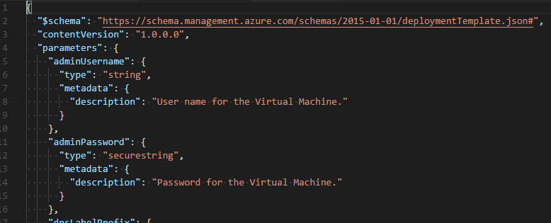
Notes:
This template deploys a virtual machine, the parameter admin password is a secure string. The rest of the deployment isn’t very important. So how do we deploy it?

Slide 40
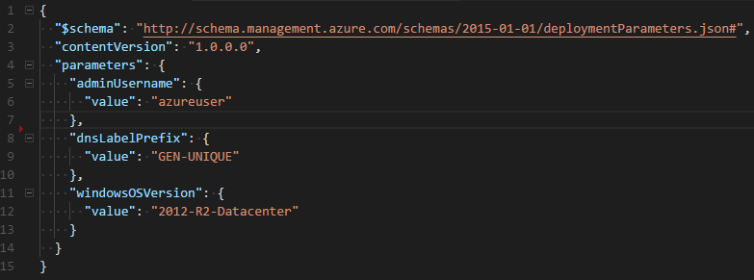
Notes:
Option 1, define a parameters file, notice that admin password is not there. When I want to deploy the template with PowerShell, I first ask the user for the credential, and then call New-AzureRMResourceGroupDeployment, specify the template file and parameter file, and then the dash admin password parameter, specifying the password from the collected credential object.
You can do something similar in VSTS as well.

Slide 41
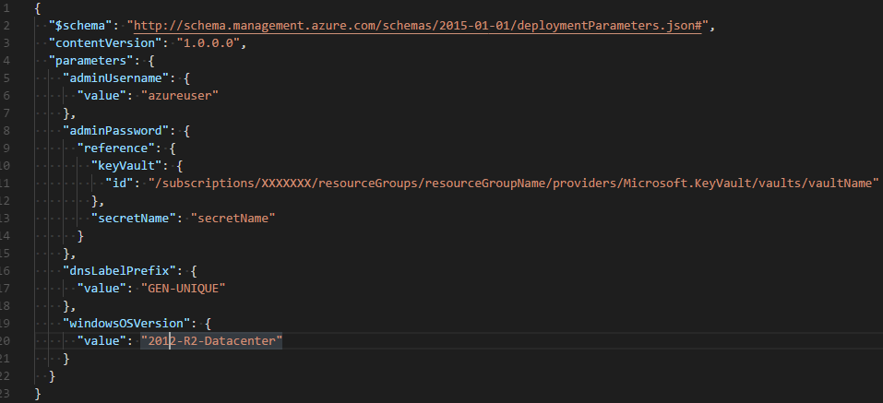
Notes:
Option 2, put the password in Key Vault. This time we do have an entry for the admin password in the parameters file, but it isn’t the password. Instead it is a reference to a Key Vault in Azure and the name of the secret that contains the admin password. When the deployment starts, ARM will get the password out of the specified Key Vault. Whilst this method can be a little bit fiddly at first, it really maintains the security of the credential. This is my preferred scenario, it just makes so much more sense.

Slide 42
THANKS!
Any questions?
You can find me at:
@kjacobsen · poshsecurity.com
Notes:
That is all for me today.
I want to thank you all for coming and listening to me today. You can find me on twitter @kjacobsen and as I said earlier, my blog is poshsecurity.com. I will post the content there in the next few days.
Thank you all very much.
<pause for applause>
We have time for questions, does any one have any questions?

